Slide 1
Growing trees from seed Operation Acorn

Slide 2
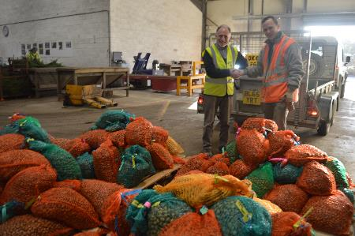
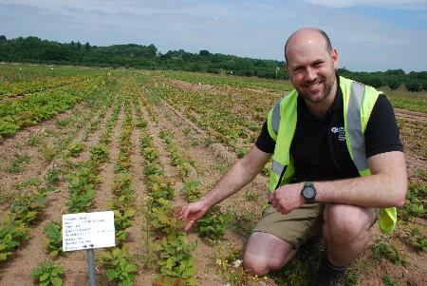
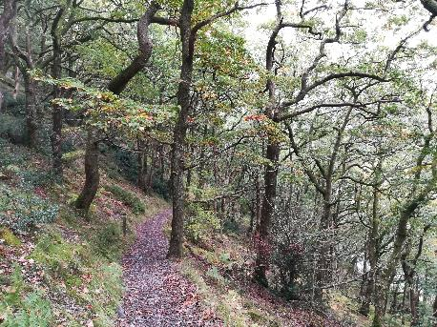
This PowerPoint presentation explains:
Why Wales needs local seed to grow the best possible trees for it’s forests
What Natural Resources Wales is doing to ensure it’s trees and woodlands are fit for the future
What happens behind the scenes at Delamere, Forestry England tree nursery to grow acorns on to become oak trees.
What happens to the trees once they are ready to leave the tree nursery and return to Welsh forests.

Slide 3
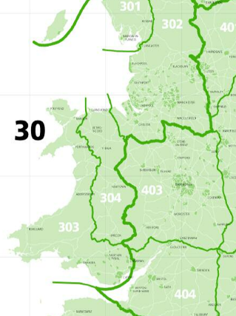
Local provenance trees
What are local provenance trees?
The term provenance describes the geographic location of a stand of trees from where seed was collected.
For trees and shrubs, Britain is divided into four regions of provenance. Each area of provenance has climatic similarity (the landscape, weather and temperature within the area is roughly the same). Wales sits in the ‘30’ region of provenance.
The regions of provenance have been sub-divided to produce 24 local seed zones which have similar ecological and climate characteristics.
Question – did your education group take part in NRW’s Acorn Antics campaign? What seed zone were your acorns collected from?
https://bit.ly/2DZ6hY2 - link to the seed zone map

Slide 4
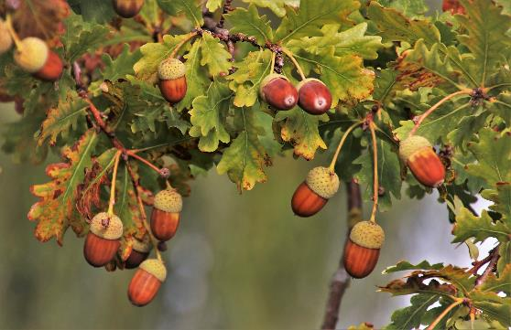
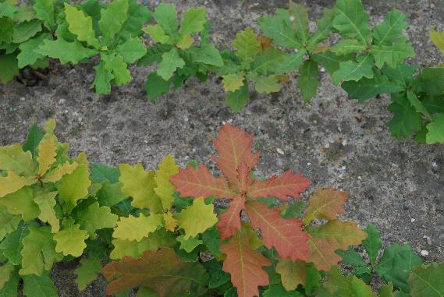
Why plant native, local provenance trees?
The planting of native, local provenance trees ensures that their genetic makeup of the trees being planted have has become adapted over time to the range of climatic and soil conditions in the place in which they are growing - temperature fluctuations, rainfall levels and wind speeds.
With increasing concern about pests and diseases in trees and the onset of climate change woodland managers are looking to ensure that the trees they plant are as resilient (resistant) as possible to outbreaks of disease and are best adapted to changing climatic conditions. Planting native, local provenance trees gives the best chance of ensuring this.
Importing trees from abroad increases biosecurity risks (the risk of the spread of infectious diseases) – for example, the tree fungus Ash Dieback (Chalara fraxinea) was brought into the UK on trees shipped over from Europe.
Notes:
Why plant native, local provenance trees?
Native trees - The term native is used for any species that would naturally live and grow in Britain – they haven’t been intentionally brought to Britain or accidentally introduced by humans. Native trees and shrubs support a wider range of plants and animals than introduced non-native species, and are more likely to survive and flourish than species which have been introduced.
Non-native trees - Non-native species are any species that have been brought to the UK by humans, either deliberately or accidentally, that would not naturally live here e.g. cedar or eucalyptus.
The planting of native, local provenance trees ensures that their genetic makeup of the trees being planted have has become adapted over time to the range of climatic and soil conditions in the place in which they are growing - temperature fluctuations, rainfall levels and wind speeds. Planting trees of the incorrect provenance can result in the grower struggling to get the trees established and in some cases, the failure and death of the trees. For example planting trees which have been collected from seed collected in the south east of England (‘40’ provenance) in the north of Scotland could result in the death of the trees as they have come from a warmer climate and would be unable to adapt and survive the colder climate.
With increasing concern about pests and diseases in trees and the onset of climate change woodland managers are looking to ensure that the trees they plant are as resilient (resistant) as possible to outbreaks of disease and are best adapted to changing climatic conditions. Planting native, local provenance trees gives the best chance of ensuring this.
Importing trees from abroad increases biosecurity risks (the risk of the spread of infectious diseases) – for example, the tree fungus Ash Dieback (Chalara fraxinea) was brought into the UK on trees shipped over from Europe.

Slide 5
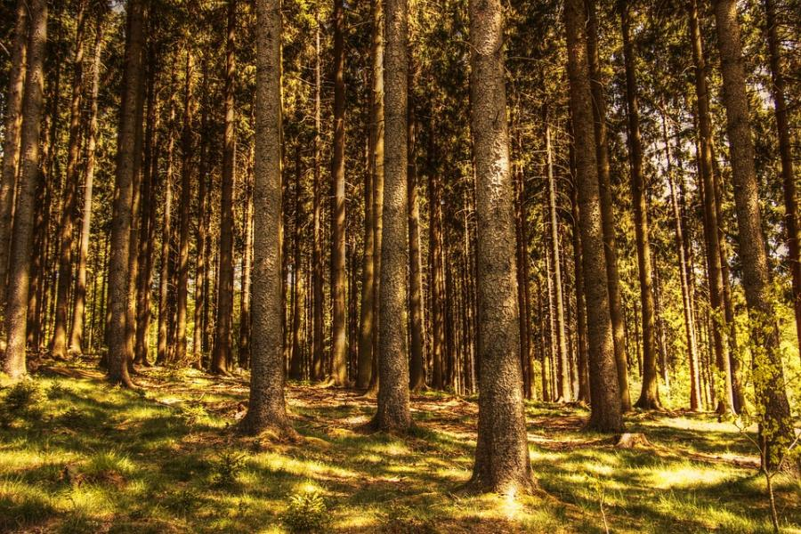
Looking to the future
In Wales, our forests and woodlands have traditionally been dominated by a very limited range of tree species with many sites (when being managed for timber production) being planted with a single species).
This is a risky strategy in light of future predicted climatic change, and a likely increase in the incidence of pests and diseases.
We recognise that by increasing the diversity of the tree species we plant and sourcing seed from an increased number of well dispersed sources, we can increase the resilience of Welsh woodlands to the impacts of climate change and pests and diseases.

Slide 6
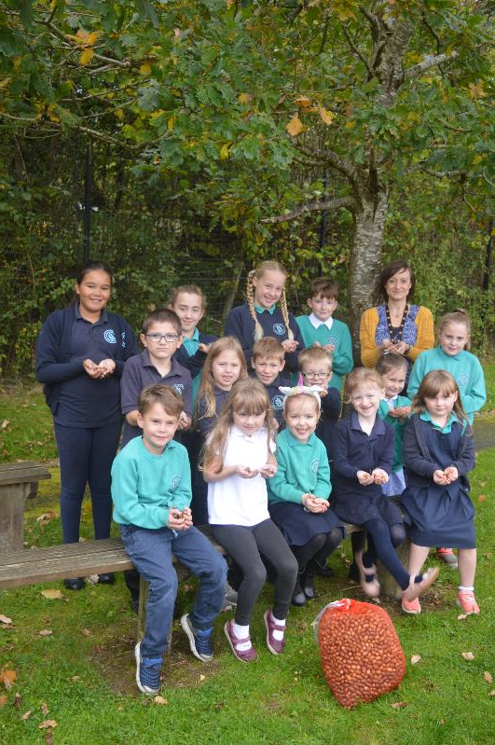
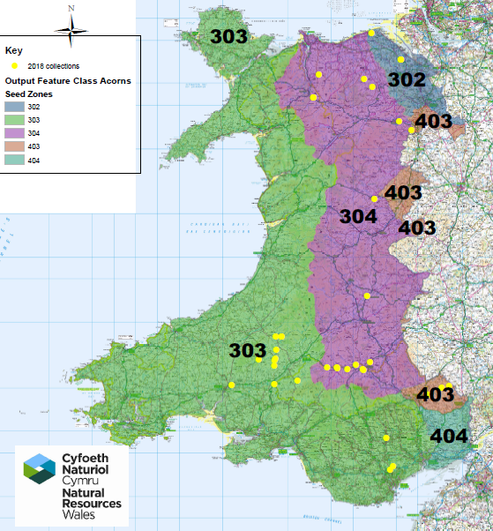
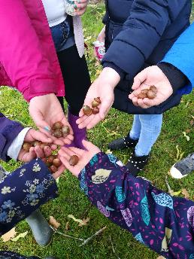
Acorn Antics project
Projects such as our ‘Acorn Antics’ campaign, which we run every autumn asks learners big and small to get outside and collect acorns on our behalf to help us meet the future challenges for our trees and woodlands face.
To learn more about NRW’s Acorn Antics campaign please visit the webpage
Map showing the locations of the 2018 Acorn Antics collections

Slide 7
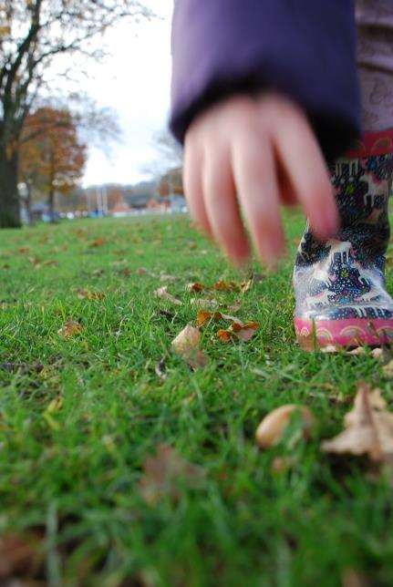
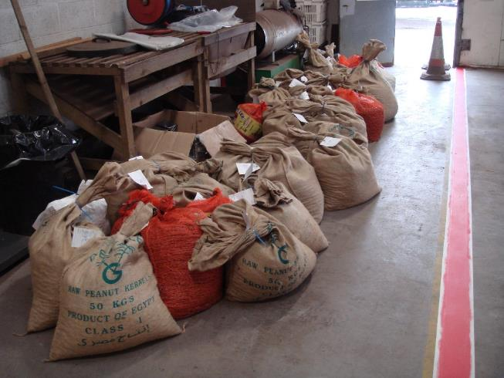
Autumn – Operation acorn begins
Acorns are highly perishable. From the moment they fall to the ground to getting them planted in the ground it’s a race against time.
Notes:
The acorn is the ripened seed of the oak tree and looks very much like an egg in a cup. Young acorns are green, maturing to brown when fully ripe.
A heavy seed, acorns have large energy reserves enabling them to spend time getting firmly established and giving them a better chance of surviving to maturity. Size does matter; larger acorns are believed to lead to larger saplings however it’s likely to be only an early competitive advantage with growth rates evening out as the trees mature and they are subject to fewer pressures e.g. frost, animal predators and competing plants.
Ripening dates vary from year to year and from county to county by as much as three to four weeks, making it difficult to advise on actual dates however they generally begin to fall from late September, particularly during strong winds and/or after the first frosts through to the first week in November.
Collectors need to keep a watchful eye on their trees - once the cold air sets in that is the time acorns will begin to drop. The first fall acorns should be discarded as they are not fully ripe – these often fall with the first autumn winds. The main fall is approximately 2 weeks later.
Acorns are ‘recalcitrant’ which means they are highly perishable. Once they have fallen from the tree they will either germinate (usually 5-15 weeks after dropping), be eaten or begin to dry out and die. To give Acorn Antics acorns the best chance of developing from a seed to a tree harvesting should take place as soon as possible after the main fall as acorns will quickly begin to decay. The longer acorns are on the woodland floor, the quicker they lose their viability.
Seed viability - A viable seed is one which is capable of germination under suitable conditions.
To maintain their viability the fruits must be kept cool with a high moisture content in a breathable atmosphere.

Slide 8
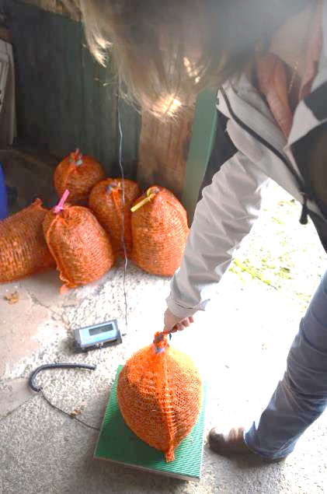
Before they can be planted…
Once received, all the Acorn Antics acorns are taken to the Forestry Commission England’s Delamere Tree Nursery in Cheshire.
On arrival the sacks are checked and weighed.
Notes:
Once NRW receives acorns from education groups they are taken to Forestry Commission England’s Delamere tree nursery in Cheshire. A state of the art tree nursery, Natural Resources Wales sources almost all of it’s conifer and broadleaf trees from the Delamere tree nursery.
Once the sacks of acorns arrive at the tree nursery they are checked and weighed. Where they have come from and who has collected them is recorded. A random sample of acorns is taken to calculate the number of acorns per kg.

Slide 9
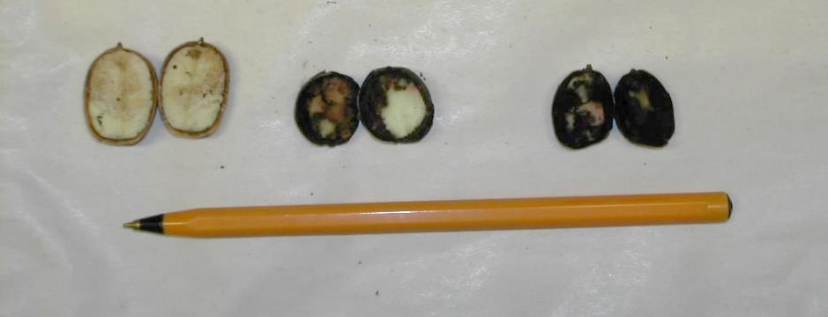
Assessing acorn quality
Discuss - Why have these acorns been cut in half?
Question - Of the acorns pictured, which do you think are of the highest quality and most ‘viable’? Explain your answer.
Notes:
Nursery staff will take a sample of acorns from each collection and undergo a ‘cut test’ to make an assessment of the viability of the seed e.g. are they viable (alive) or are they dead. This involves literally cutting some acorns in half and doing a visual assessment.
Seed viability - A viable seed is one which is capable of germination.
The cut acorns on the left in the photo have a higher viability than those in the middle which have begun to perish. The acorns on the far right are dead. The quality of the acorns received will determine how thickly they will be sown. Poor quality acorns are sown thickly whilst good quality acorns are sown less densely in the hope that they will all germinate even if sown at density.

Slide 10
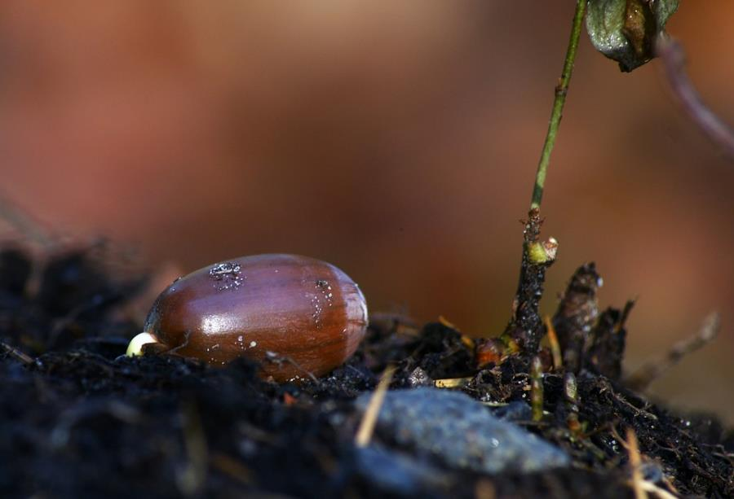
The race to germinate
Once all the acorns have been received and checked a germination test is undertaken.
Question - What is a germination test?
A germination test estimates the percentage of acorns within a sample that are capable of germinating.
Question - Why do a germination test?
Knowing the germination rate of a particular seed is key to understanding how well that seed will grow once sown.
Video of an acorn germinating, filmed over 8 months - 1.26 minutes
https://www.youtube.com/watch?v=ijmMA9hlo00
Notes:
What is a Germination Test?
A germination test estimates the percentage of acorns within a sample that are capable of germinating.
The germination rate of acorns is the number of acorns germinated against the total number of acorns planted.
Why do a Germination Test?
Because knowing the germination rate of a particular seed lot is key to understanding how well that seed will perform once sown.
If your seed has a 90% germination rate, it means 90 out of 100 seeds are likely to germinate under good growing conditions. You can use this information decide whether the seed you have will produce a decent crop, calculate the best seeding rate, or whether the seed should be used at all.

Slide 11
Time vs average acorn germination rate
Acorns ripen on tree and begin to drop
Acorns collected
Acorns sown in the ground at the nursery
Question – what impact does time have on the germination % rate of acorns?
What is the germination % rate when the acorns:
Drop from the tree?
Are collected?
Sown in the ground at the nursery?
Notes:
Even in a tree nursery environment with the best methods of artificial storage, the germination rates of acorns decline as they dry out. This makes their storing and growing difficult.
Slow deterioration will take place in the weeks between acorn collection (September – early November) and sowing (mid November) but once sown in the ground the germination rate will level off.
Typically, acorns are sown ranging anywhere from 99% to 60% germinability.

Slide 12
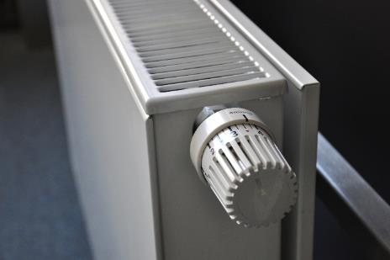
Keeping deterioration at bay
Question – What factors might speed up the deterioration of an acorn and reduce it’s chances of successfully germinating?
Notes:
There are a number of human and environmental factors that will speed up the deterioration rates of acorns and reduce their chance of successfully germinating and growing on to become trees.
Keeping cool – to slow down the rate of deterioration and minimise fungal growth, acorns need to be stored at a low temperature (2ºC - 5ºC) and away from the perils of indoor heating.
Keeping moist – acorns are used to being outside. Dry air will accelerate the drying out process, they should be stored somewhere cold and damp.
Beware of wildlife – nibbled acorns have a reduced chance of germinating, wherever acorns are stored needs to be visitor proof.
Let them breathe – Acorns are living organisms and need to be able to respire. They need space and air to breathe.
Handle with care – Acorns need to be handled delicately and gently as if they were fine china - mishandling will damage or kill them.

Slide 13
Acorn rates of germination
The average number of viable acorns is:
250 per kg. for sessile oak
220 per kg. for pedunculate oak
The approximate number of oak trees that will successfully germinate per kg. of acorns is 80-120 for both sessile and pedunculate.
Question – If 250 sessile acorns are planted and 120 acorns successfully germinate, what’s the acorn germination rate as a %?

Slide 14
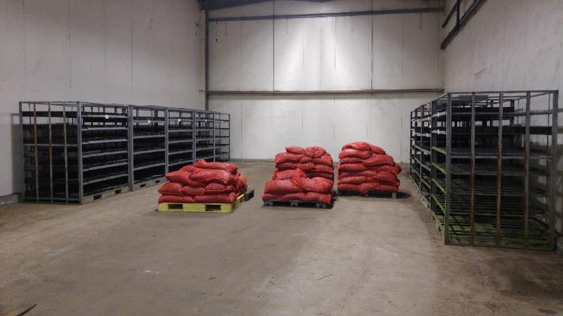
Winter - Storing acorns
Once they have been checked, acorns are sorted and tipped onto trays and stored on pallets.
When it’s been confirmed that all the acorns have been delivered to the nursery, the trays are emptied and acorns grouped according to their species and region of provenance in the coldstore.
Notes:
After an initial inspection upon delivery, acorns are tipped into trays which have holes in them to help promote airflow around the acorns to slow mould growth.
Acorns are then grouped together according to their species and region of provenance. Kept in trays, ordered and stored on pallets the acorns are kept in a large coldstore (think massive walk in fridge) in which the temperature and humidity can be controlled to stop the acorns from drying out.

Slide 15
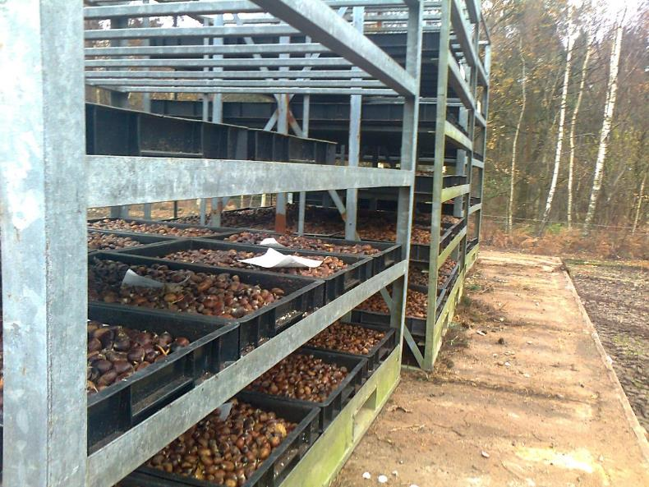
Preparing to sow
Once all collections have been received the acorns are mechanically sown (by a machine) into seed beds as soon as possible to reduce the rate of acorn deterioration – usually end of November.
Video of the acorns being mechanically sown – 35 seconds https://youtu.be/Lt-FrVBhE_Y

Slide 16
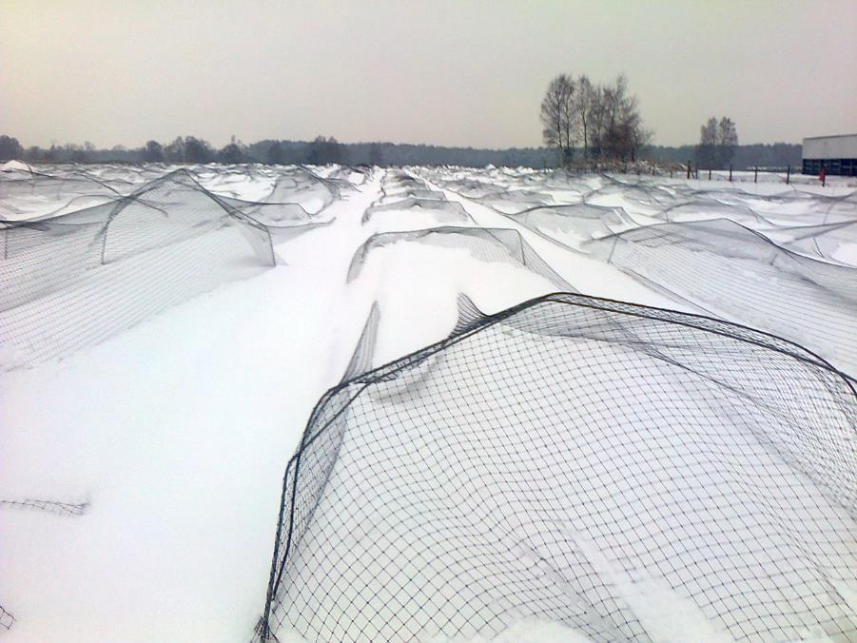
Seed beds
Question – why are the seed beds netted?
Notes:
Once sown, the seed beds are labelled and roughly mapped. A netting team will then net the beds to prevent birds from taking the acorns. Other pests such as squirrels are monitored and action taken if required. Herbicide is applied during the winter to kill any weeds.
The acorns are left to germinate and are revisited later in the year.

Slide 17
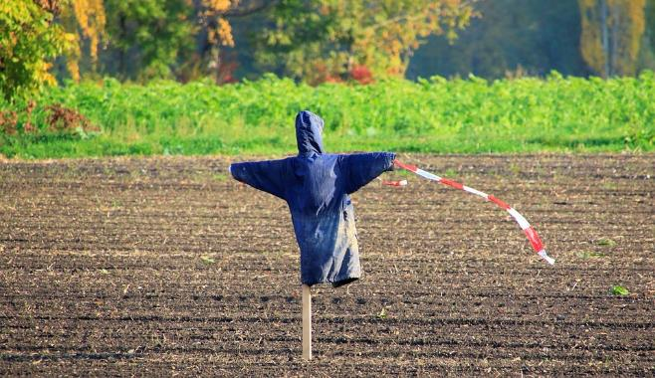
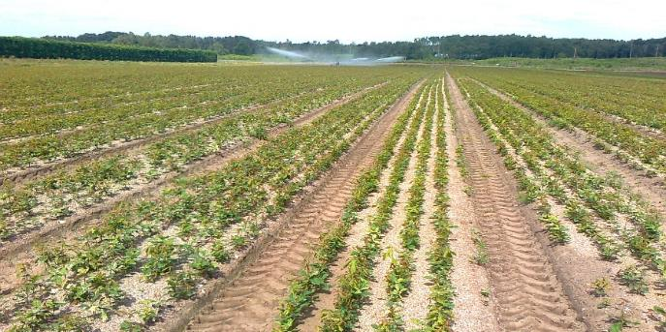
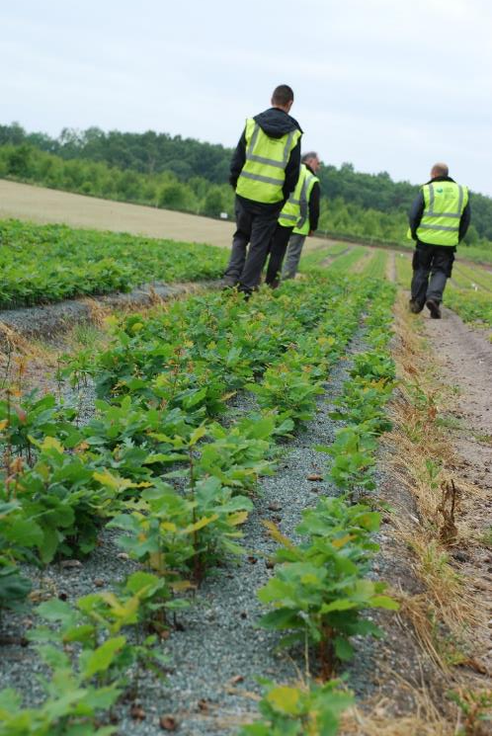
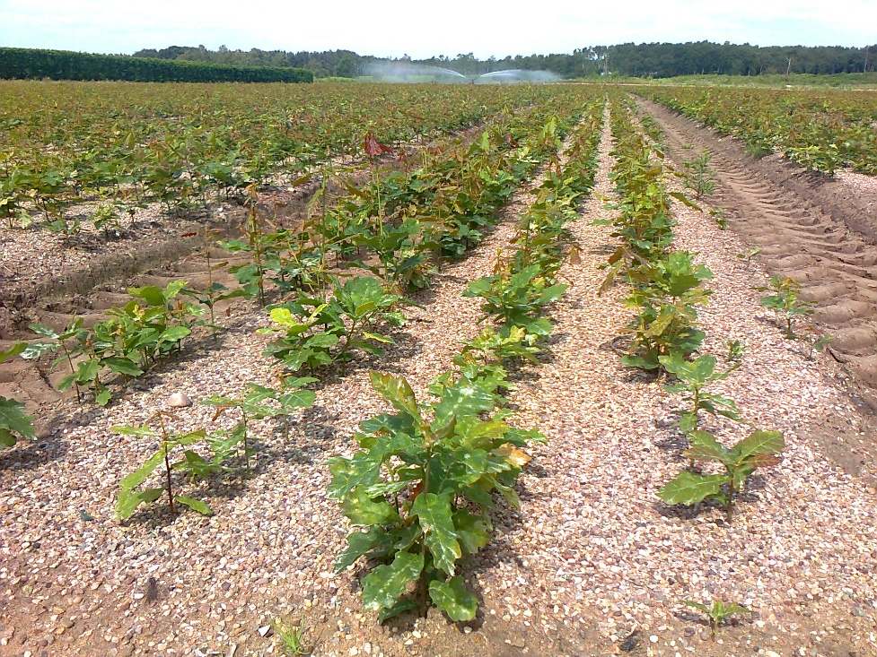
Spring - Nurturing young saplings
Notes:
Roughly 10 days before the acorns emerge the beds are sprayed with herbicide to stop weeds from coming through. Nets are removed as the trees emerge.
To ensure the trees are given the best chance to grow, bird scarers are installed, kites and bird bangers (cannons that produce a loud bang that will make the birds and wildlife move on quickly) to deter birds from nibbling at the young saplings.
A germination stocktake is done to calculate the germination rate of the seed planted i.e. of the 250 acorns that were planted, 70% have germinated.
The crops are irrigated (watered) and any weeds are pulled. Fertiliser is applied if needed.

Slide 18
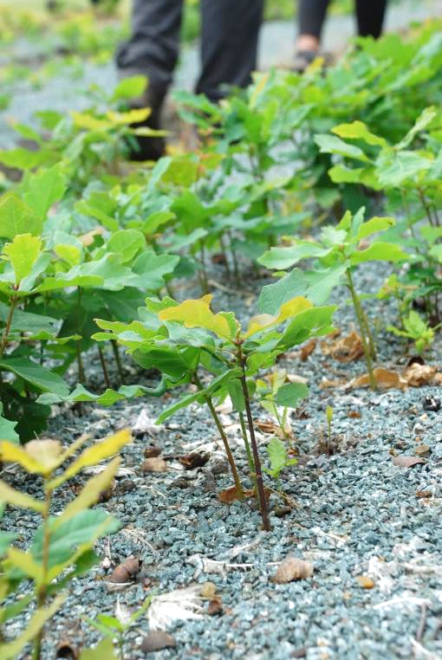
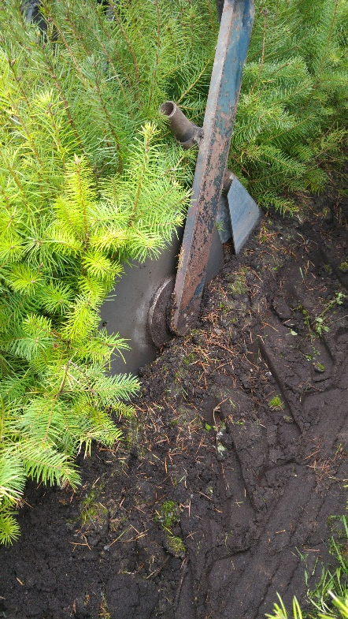
Summer - Undercutting
Undercutting is completed once the saplings have emerged and new growth has had a chance to establish.
Undercutting involves drawing a horizontal mounted blade on a specialist machine through the soil at a certain depth below a bed of young trees to sever the deeper tree roots.
Undercutting young conifer trees
Notes:
Getting the timing right is difficult as the saplings need time to establish but it shouldn’t be done when ground conditions are dry as there is a risk that the procedure will kill the trees! This was a huge problem in 2018 when temperatures soared during a prolonged dry spell. To enable the trees to be undercut the nursery had to irrigate (water), undercut and irrigate the ground again which proved very time consuming.

Slide 19
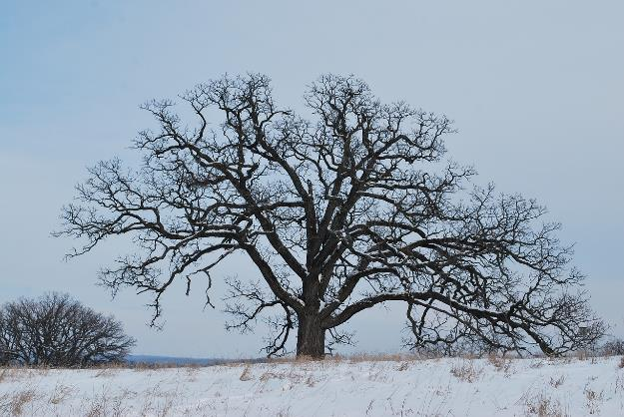
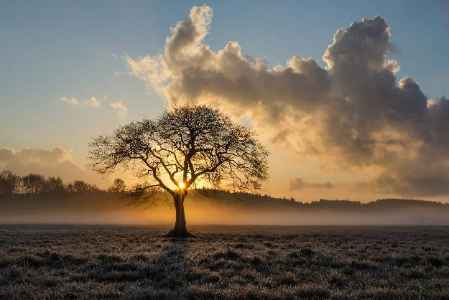
Dormancy
Undercutting is performed whilst plants are dormant.
Question - What is dormancy in trees?
Dormancy - is a period in a tree’s life cycle when growth and development are temporarily stopped.
The dropping of leaves indicates that trees are becoming dormant.
Trees enter the dormant or ‘resting’ season based on the decrease in temperature and the decrease of daylight received as autumn retreats into winter. Like hibernating animals, trees fill themselves with food before winter, using it up slowly during the cold dormant months.
Notes:
Everything within the tree - metabolism, energy consumption, growth and so on slows down.

Slide 20
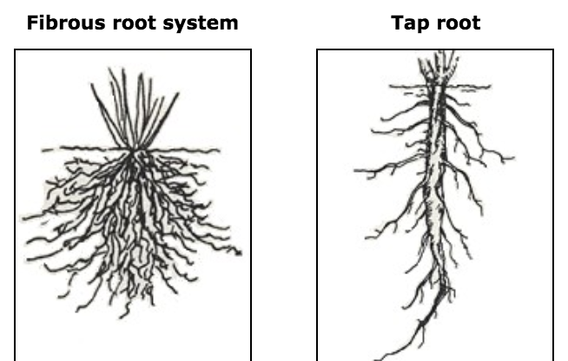
Fibrous vs tap root systems
Root system of a plant that has been undercut
Root system of a plant that hasn’t been undercut
Question – what are the observable differences between the two root systems?
Question – which root system do you think has developed as a result of being undercut?
Question – Why do you think a fibrous tree root system is more favourable to a tap root system in the tree nursery?
www.thedailygarden.us/garden-word-of-the-day/roots
Notes:
Differences between a fibrous root system and a tap root system
A taproot is when there is one main root that grows straight down deep into the soil. It only has very few lateral roots that develop and grow off this main root. A fibrous root is a root that consists of groups of roots of similar size and length. A fibrous root system does not penetrate deeply into the soil but rather creates a thick network of roots that are good at holding the soil together.
What are the benefits of undercutting?
Undercutting roots stimulates extra roots to grow, producing a bushier root system. The more roots you have on a plant the better/easier it will establish.
Undercutting prevents taproots from growing too deeply which may be problematic when it comes to lifting the trees out of the soil.

Slide 21
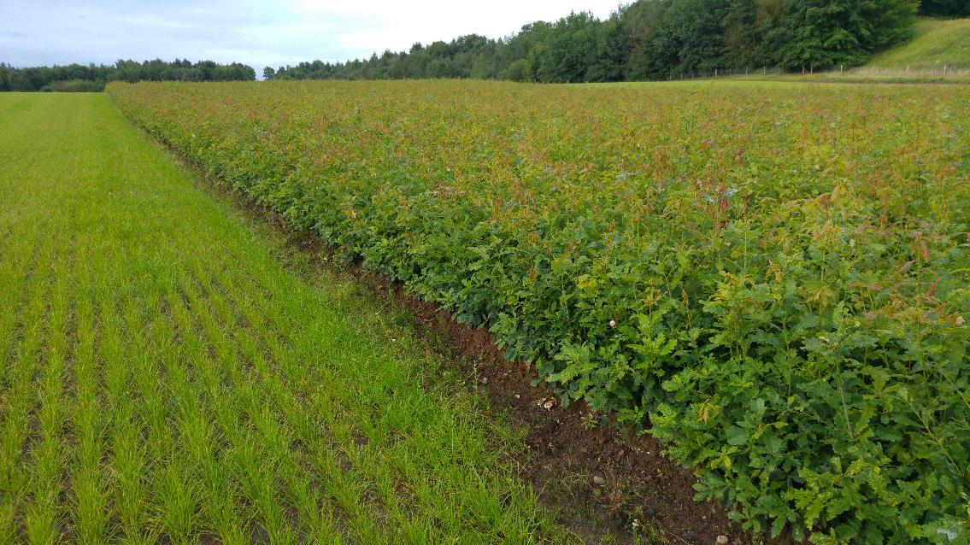
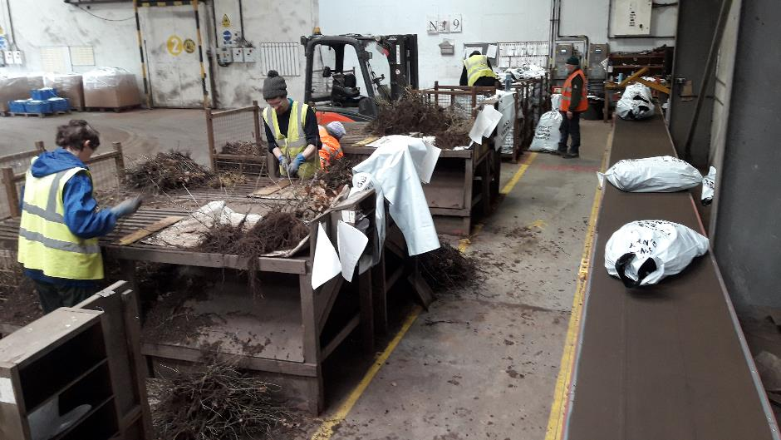
Autumn/Winter - Lifting and planting
During the autumn the trees are counted and their heights measured.
As the trees become dormant in the late autumn/winter they are ready to be mechanically lifted (dug up by machine). To check whether or not they are fully dormant the tree nursery carries out a ‘Root Electrolyte test’. Only when the checks show that the trees have reached a certain level of dormancy, can they be lifted. They are then graded (best to worst), counted into bags and are ready to go to the forest for planting.
Delivered by road, once the trees have been received by Natural Resources Wales they are planted back in the seed zone from where they were collected as an acorn.
Grading the trees at the tree nursery
Notes:
In the autumn the trees are counted and heights measured so that the nursery knows how many trees of what sizes they have available. As the trees become dormant in the late autumn/winter they are ready to be mechanically lifted (dug up by machine). To check whether or not they are fully dormant the tree nursery carries out a ‘Root Electrolyte test’. Only when the checks show that the trees have reached a certain level of dormancy, can they be lifted. They are then graded (best to worst), counted into bags and are ready to go to the forest for planting.
Those that don’t make the grade or are too small after one year’s growth are kept dormant and put in the coldstore to be planted out again in the spring. These trees will go on to be planted in a forest after their second year in the nursery.

Slide 22
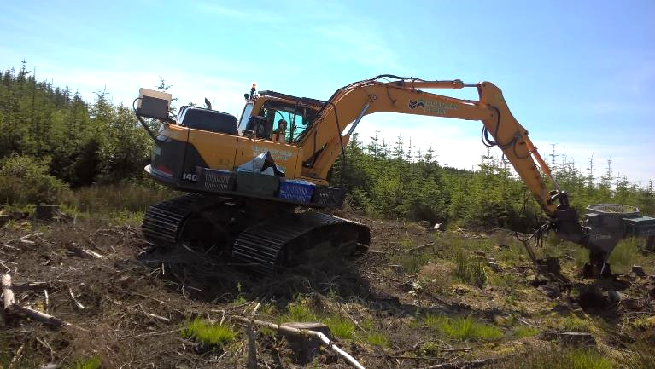
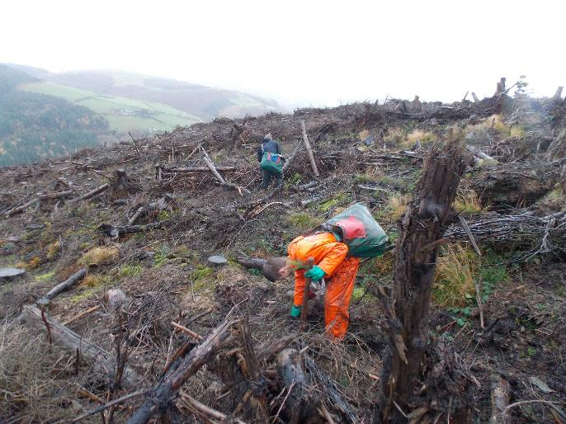
Winter/Spring - Planting out
A race against time and the elements, planting will have to be completed by the spring and the winter’s heavy rain, frost and snow will all hamper the tree planting teams.
Whether they are planted by mechanical or human means, a small, deep hole is made in the ground. The young oak trees are carefully placed in the hole, all the roots are carefully immersed before being covered with soil.
As the trees mature, we monitor them for up to five years after they’ve been planted to ensure they are surviving. In some areas, weeding may be necessary to ensure the trees survive into the future.

Slide 23
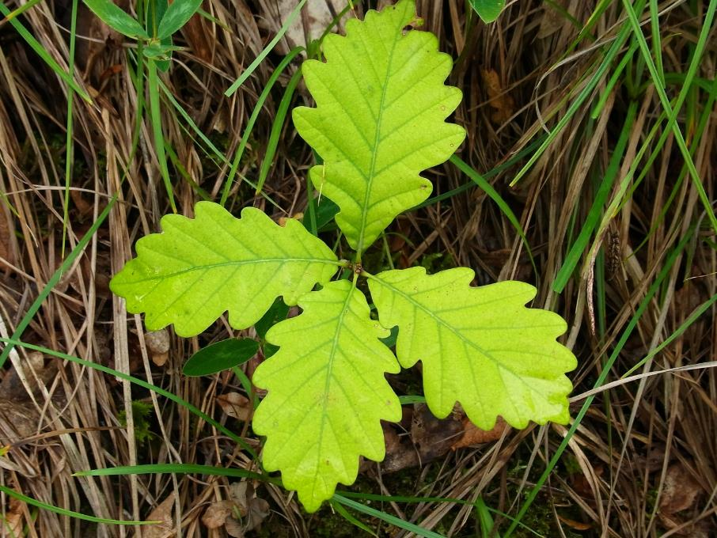
Conclusion
With high rates of deterioration it takes a lot of time and effort to successfully grow acorns onto young oak trees.
Throughout the year various tasks need to be undertaken to give the collected acorns the best chance of survival. There is never a quiet time in the tree nursery.
Due to their high value for wildlife, the environment and people – each acorn is valuable and worth the effort.
Notes:
Want to learn more about Oak trees? Inspired to have a go at growing your own acorns onto trees? Check out the ‘Trees and Woodlands’ page for our ‘Spotlight on Oak’ PowerPoint, How to grow an acorn (information note) and much more.
https://bit.ly/2RSomQ1

Slide 24
The end

