Slide 1
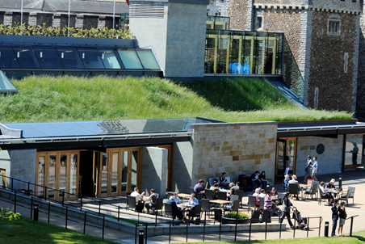
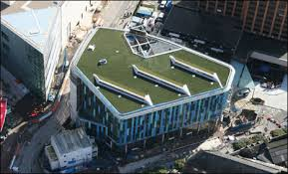
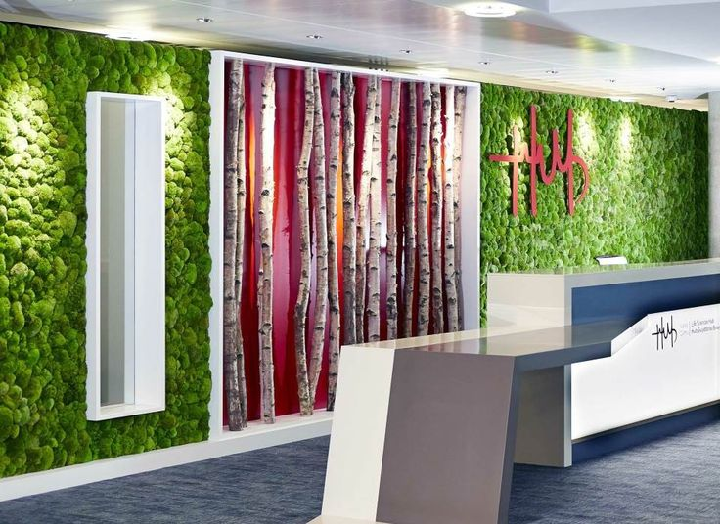
Not just a pretty façade?
Effects of on-building green infrastructure on urban microclimate
Peter Wootton – Beard Ph.D. IBERS, Aberystwyth University – Wales GI Forum – 4th October 2017
© Cardiff castle
© Cardiff Library
© Life Sciences Hub, Cardiff
Financial support provided by the Welsh Government and Higher Education Funding Council for Wales through the Sêr Cymru National Research Network for Low Carbon, Energy and Environment

Slide 2
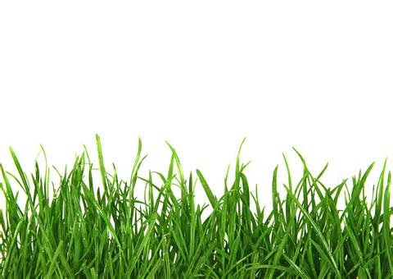
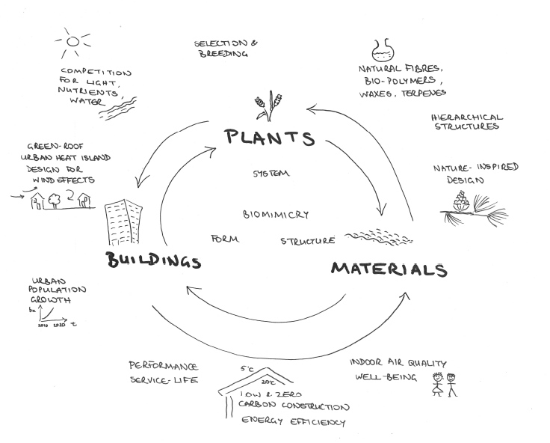
Plants and Architecture
IBERS, Aberystwyth University
Biocomposites, Bangor University
Welsh School of Architecture, Cardiff
pcw1@aber.ac.uk
@PlantsArchitect
NRN Plants and Architecture project
Notes:
The Plants and Architecture project was proposed to answer questions concerning the integration of plants and plant products into the built environment, either directly or via biomimicry (particularly in the case of materials and architecture). Financial support for the project is provided by the Welsh Government and Higher Education Funding Council for Wales through the Sêr Cymru National Research Network for Low Carbon, Energy and Environment. Peter has two main stands to his work – the first is on-building green infrastructure (green walls, facades and roofs) and the second is building integrated agriculture (often called Vertical Farming).

Slide 3
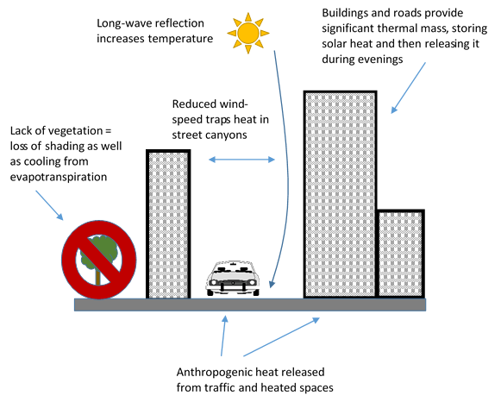
Notes:
This slide captures the challenges posed by modern cities, particularly in terms of urban heat island. The loss of trees and greenery from cities only exacerbates the problem of anthropogenic heat and radiation contributing to elevated temperatures.

Slide 4
Water
Shading
Albedo
Urban Climate
Prevent heat/sunlight from reaching a surface
Reflect a greater proportion of the light reaching a surface
Add water to atmosphere to cool air
Air
Remove pollutants, consume CO₂, produce O₂
Notes:
Plants can contribute to the mitigation of a deleterious urban climate through several mechanisms. The degree to which they contribute towards these factors is context dependent, and will be affected by a large number of physiological parameters.

Slide 5
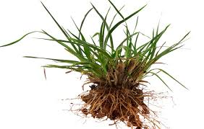
Water
Used for growth and photosynthesis
Transports materials
Keeps the leaf cells rigid
Draws nutrients from the soil into the roots
Notes:
Water: The first mechanism is by contributing water to the atmosphere. Water is fundamental to the functioning of plants, and they use it for a range of purposes. The key message from this is plants want water. They are therefore a useful conduit for moving water from one place to another.

Slide 6
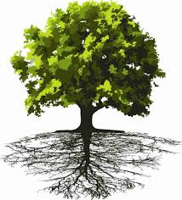
Water potential:
Air: 10-100 MPa
Leaf: 7 MPa
Leaf Cells: 1 MPa
Stem: 0.8 MPa
Base of Stem: 0.6 MPa
Soil: 0.3 MPa
Notes:
Plants draw water through their tissues by utilising a water potential gradient. In this way water rises through the plant and is transpired from the leaves. As water leaves the leaves and joins the air it creates a ‘vacuum’ type effect which draws more water from the soil, and so the cycle continues. If there is water in the soil, plants are an excellent way of transferring it to the air!

Slide 7
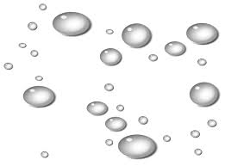
Evaporation
Transpiration
+
=
Evapo-transpiration
Notes:
There are two mechanisms by which plants return water to the air. Transpiration is the plant equivalent of our breathing, and they return water in their ‘breath’ (also some handy Oxygen!). Rain water than is intercepted by the leaves of a plant as it falls can also be heated by the sun and return to air via evaporation. These combined mechanisms are referred to as ‘evapo-transpiration’ and represent the total amount of water that a plant is contributing to the air.

Slide 8
Plants lower air temperature using evaporative cooling.
When water is heated the increased energy first breaks OH bonds, then the temperature increases.
The need to break OH bonds makes water more resistant to temperature changes than other molecules.
Having more water vapour in the air increases humidity and stabilises air temperatures.
Notes:
So, plants cool the air through evapo-transpirative cooling. It’s because of the unique properties of water that they are able to do so. Water contains OH bonds, and when it is heated those bonds have to be broken. The bonds are broken first, and then the temperature increase, making water more resistant to temperature change than other molecules. Therefore, if the water content of the air (water vapour) is higher, then humidity increases and temperatures are stabilised. On a global scale, this is the effect that the oceans have on our planet, making it (mostly) inhabitable. On a smaller scale, it’s the effect that a park has on the surrounding neighbourhood, or a planted courtyard has on the building it is inside.

Slide 9
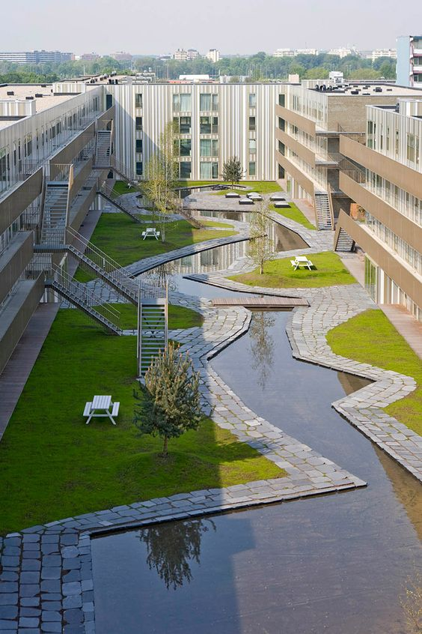
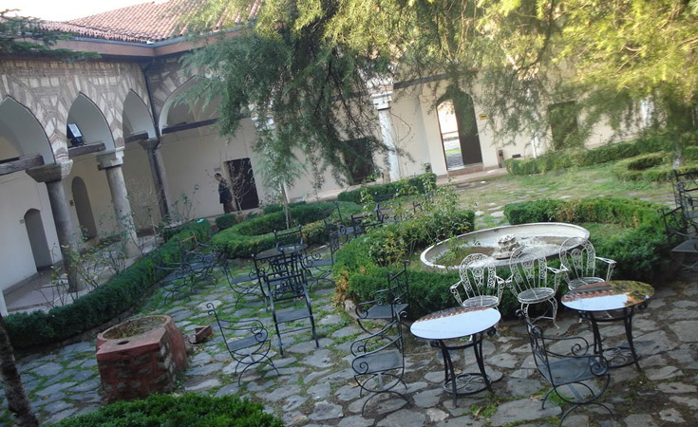
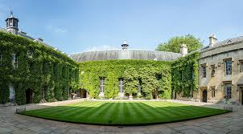
© University of Oxford
Notes:
Courtyards are a small scale example of how we have used this mechanism in traditional architecture. Vernacular architecture in many (particularly hot) countries features planted courtyards and fountains in the centre of buildings to provide evaporative cooling that was often coupled to passive ‘stack’ ventilation. The cool air produced in the courtyard could be drawn through a building (in much the same way as water is drawn through a plant) to provide coolth, long before air conditioning was available. This low carbon ventilation technology is experiencing a resurgence as energy prices and carbon footprinting are driving a need to explore passive technologies.

Slide 10
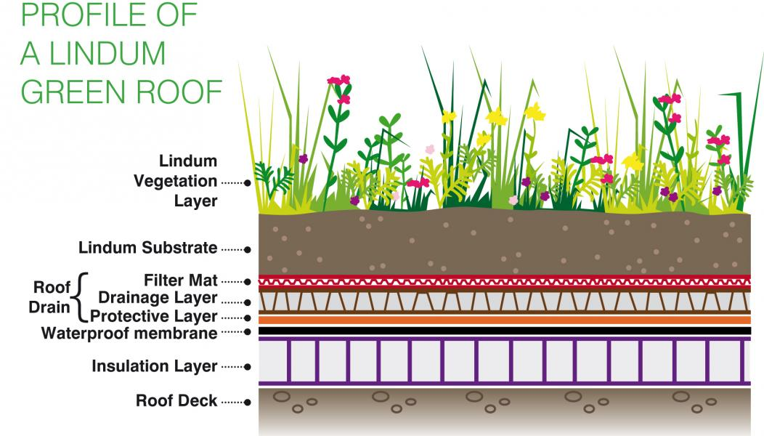
Maximise the ability of the vegetation to move water
Maximise the ability of the substrate to move/store water
Store additional water in a drainage layer
© Lindam Green Roofs
Notes:
Applying these principles to a green roof we find three key determinates of it’s ability to provide this ‘ecosystem service’. 1. The ability of the vegetation to move water. 2. The ability of the substrate to move/store water (related to properties such as hydraulic conductivity and permeability. 3. The storage of additional water in engineered solutions that is available for the plants to move.

Slide 11
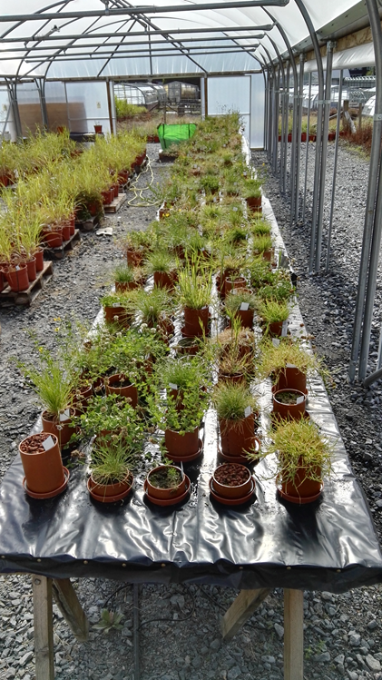
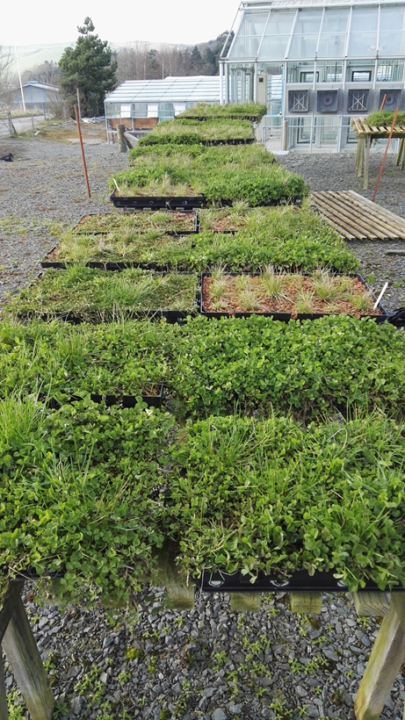
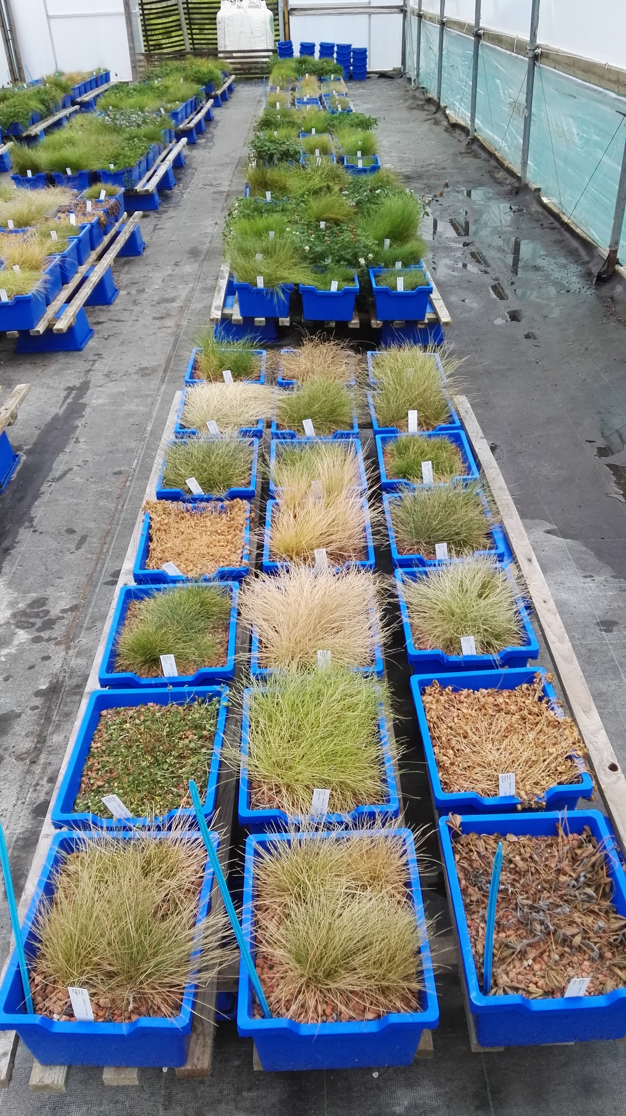
Notes:
One key determinate of the plants ability to move water is whether or not they are alive! Green roofs, particularly lightweight green roofs are harsh environments, and plants regularly face multiple challenges such as drought, nutrient depletion, high winds, shading and even waterlogging in wet winters or during intense rainfall. These images show some of the experiments that I am conducting at Aberystwyth university. Far Left: A trial of turf and legume species at 3 different substrate depth and on two different substrates. The results showed us which species could adapt to the shallow soils and what effect the soils had on their growth. Plants adjust their growth to match their environment, a trait called ‘plasticity’ some exhibit greater plasticity than others, and these are the ones we want to focus on for green roofs/walls. Centre: Different mixtures of grasses and micro clover varieties grown outdoors in green roof modules (6cm depth). This experiment sought to challenge the plants from the first experiment to cope with whatever the weather would throw at them. We had a 5 week period of drought during the experiment, which allowed us to see which species survived and which new species colonised the roofs after the drought. Far right: Knowing the types of species that are best adapted, we raided our genebank (containing collections of seed from around the world) for seed which had been collected from particularly challenging environments, we then compared the drought resistance of these to some current commercial varieties by withdrawing all water for 6 weeks. We have just started to re-water this experiment to study the recovery and results will be available early next year.

Slide 12
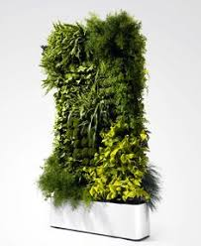
Maximise the ability of the vegetation to move water
Maximise the ability of a substrate to move/store water
Store additional water in a storage tank
Notes:
This slide applies the same principles to a green wall. The aims are the same, and the processes are largely the same. That being said, walls are still designed much more for their appearance than for the function they are intended to serve. Perhaps because the only function people believe they can perform is to look nice?

Slide 13
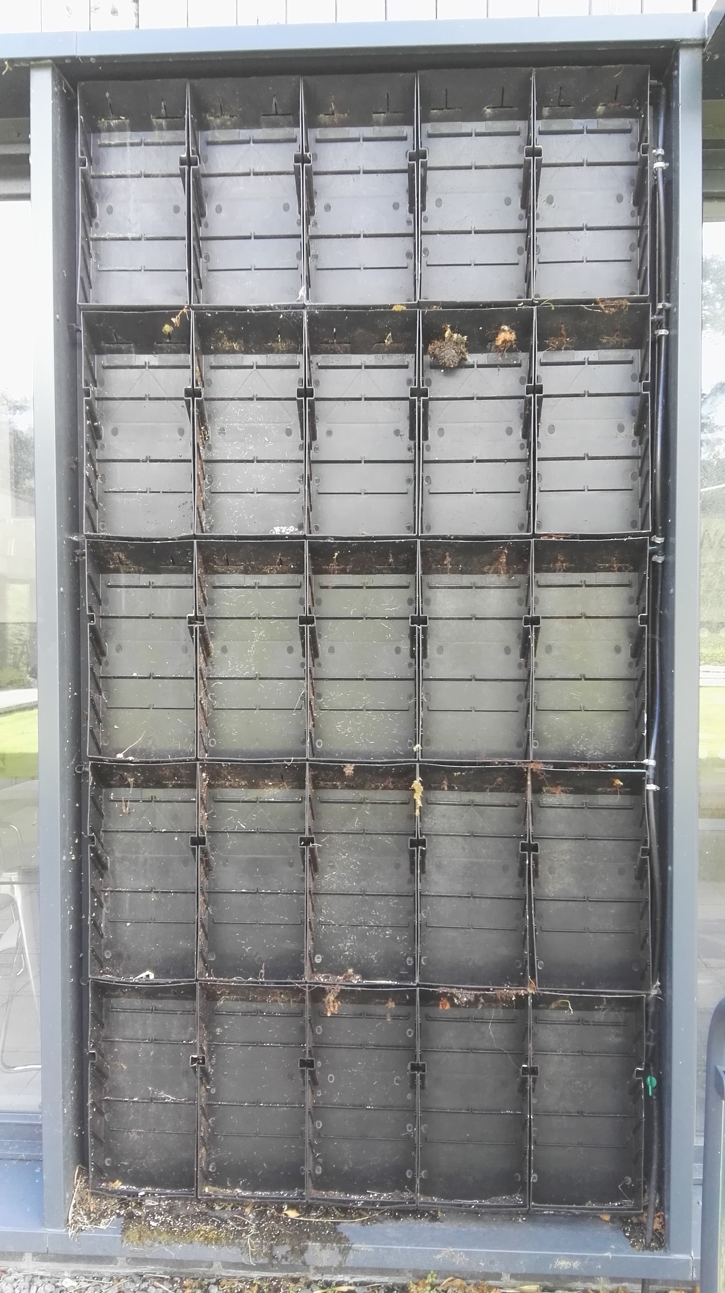
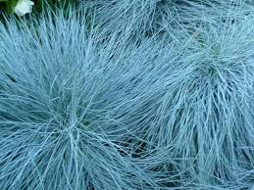
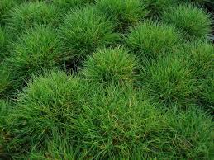
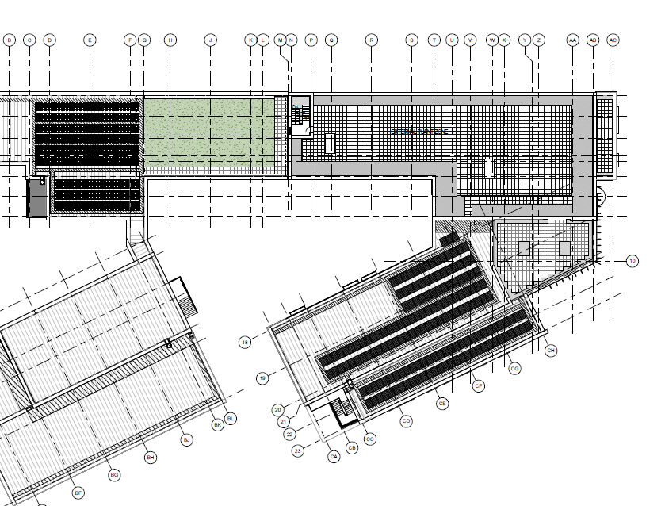
© IBI Group
Notes:
We have a green wall at the university, and we will soon have a few more. Our green wall was built to look pretty and no data was ever collected as to how it performed as a building façade. In the summer of 2017, the wall failed for a variety of reasons. We have decided to renovate it, and instrument it both to understand what the environment we are asking plants to tolerate is actually like, and also to understand the impact of the wall on our buildings. This will inform the green walls and roofs that are installed on our new innovation campus, due to be completed in 2019.

Slide 14
On an individual roof:
Drainage layer:
+ Increase depth - Increases weight
Substrate:
+ Increase depth - Increases weight
+ Increase WHC - Increases weight
+ Increase HC - Decreases storage value
Vegetation:
+ Use green plants - Increases drought susceptibility
+ Increase leaf area - Increases drought susceptibility
+ Increase diversity - Requires greater maintenance
Notes:
The challenges of providing greater evapotranspiration on a green roof.

Slide 15
Overall:
Drainage layer:
+ Increase water storage technologies
Substrate:
+ Install maximum depth possible
+ Use substrates which focus on plant health rather than weight
+ Standard performance tests (STRI)
Vegetation:
+ Use more green plants rather than succulents (unless arid)
+ Increase the area of green roofs in a city, the effects are cumulative
+ Increase diversity
Notes:
The positive steps that can be taken to make a green roof more useful as a source of evaporative cooling.

Slide 16
Notes:
A simple schematic to show that the biggest impact we can have on urban heat island is to create more green spaces, which will create more evapotranspiration, and a greater cooling effect. The other option is to generate less heat, but with cities growing at an alarming rate, this seems less plausible.

Slide 17
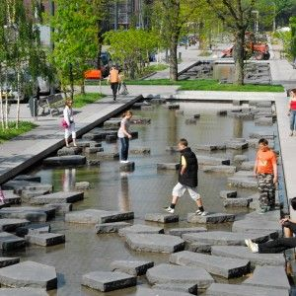
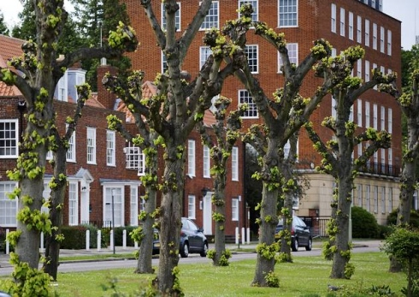
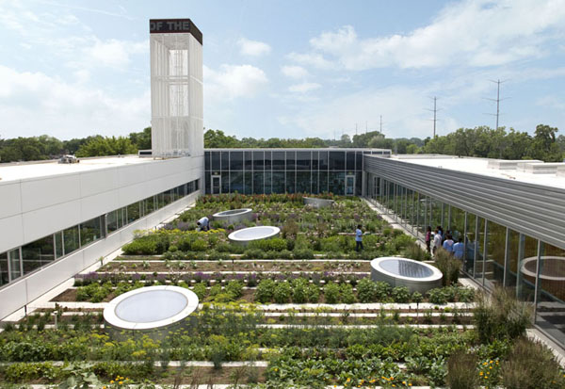
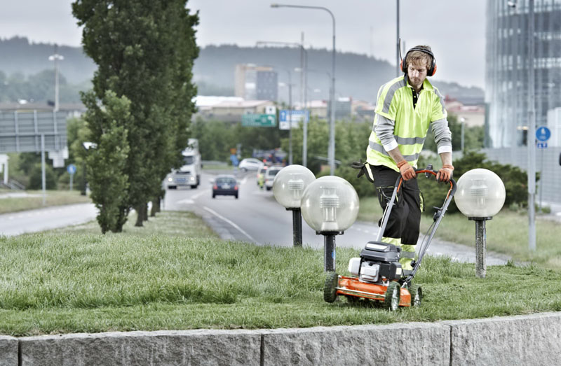
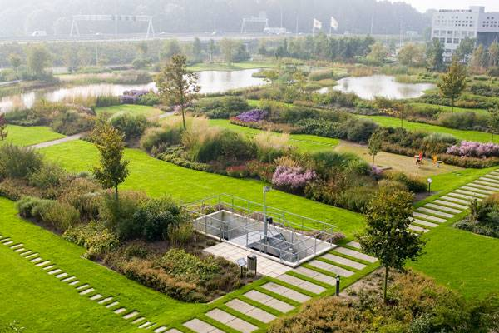
Reduce leaf area
Maintenance
Development
Beautifying
Replace with
Designed GI
On-building spaces
Designated areas of low maintenance
© Buro Sant en Co Architecture
© Gary Comer Youth Centre, Chicago
European Patent Office, Rijswijk © Van der Tol
Notes:
Plants in an urban environment have to be managed. It’s therefore important to think not just that ‘green is good’ but rather ‘what kind of green would be best’. It’s less effective to plant street trees is they are pollarded every couple of years, or to have grassed areas if they are closely mown. If the maintenance regime removes all the green parts of the plant, then their ability to cool the environment is severely limited. Urban planning needs to think about why the green space is there, and manage it for the functions which are desired of it. Recreation/aesthetic beauty is just 1 of these potential functions, but it has been dominant as a motivation for the maintenance of urban spaces.

Slide 18
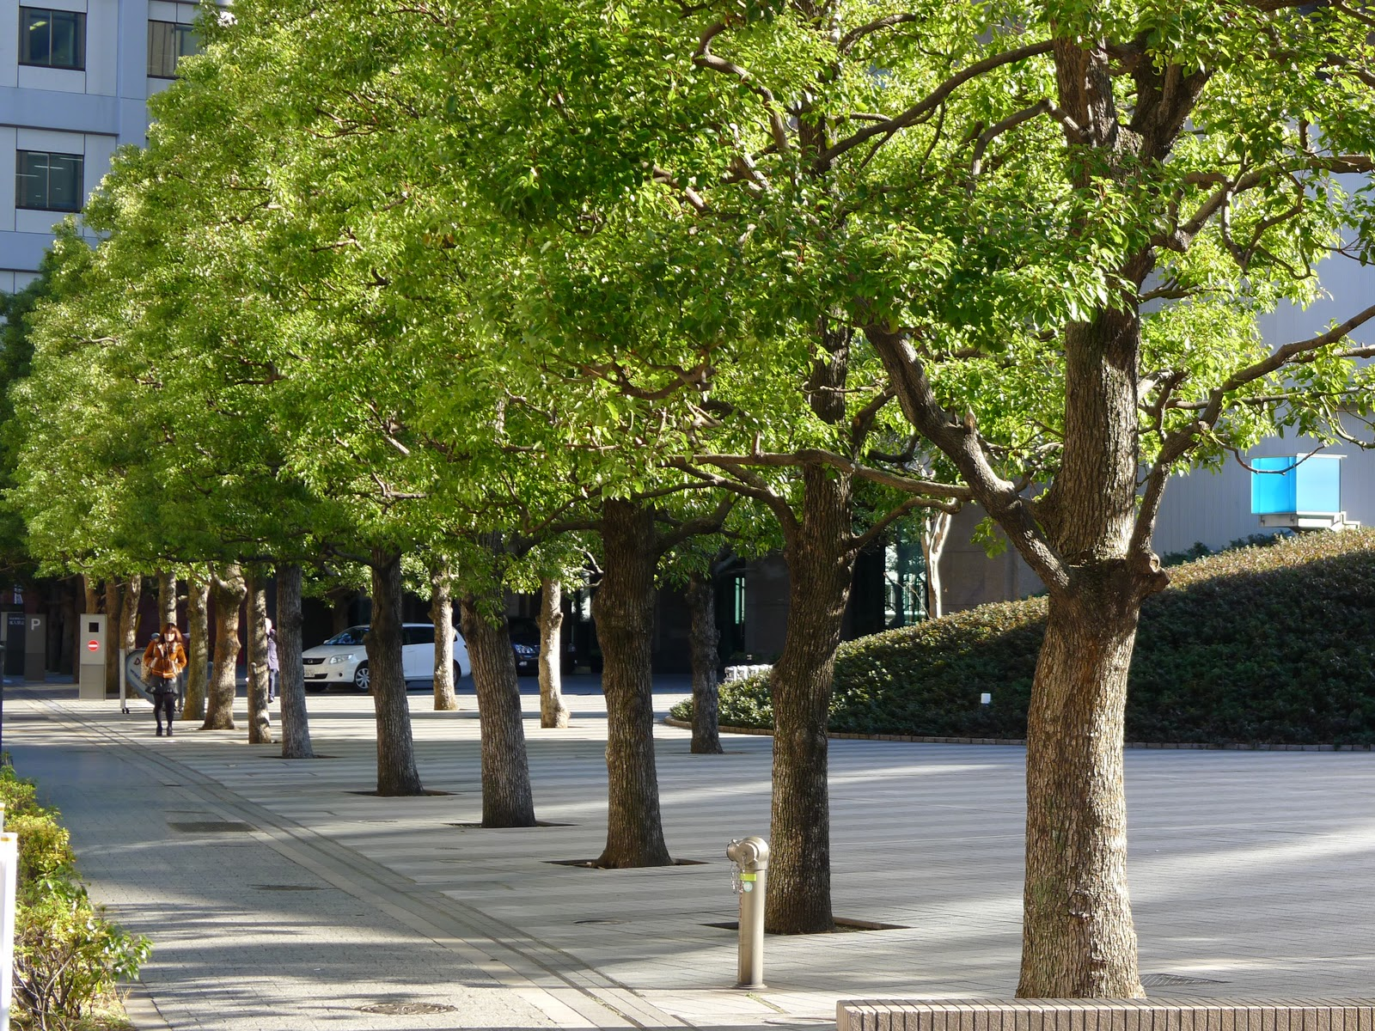
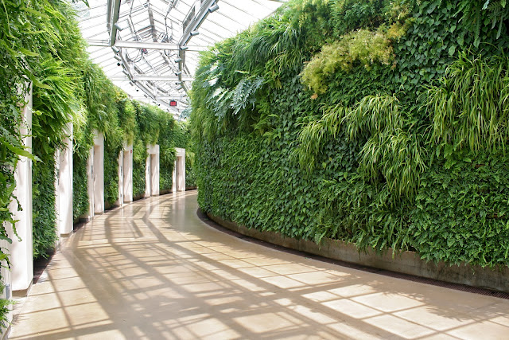
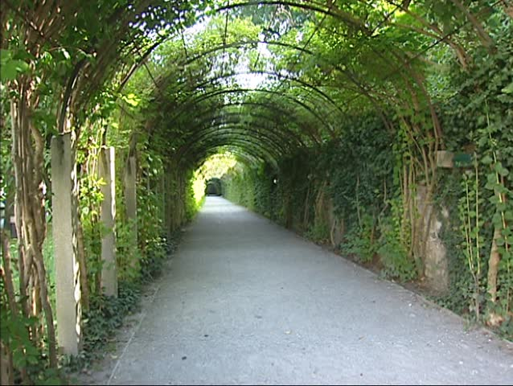
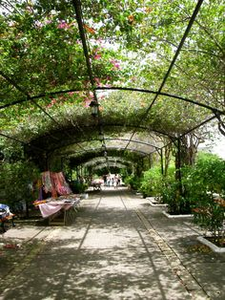
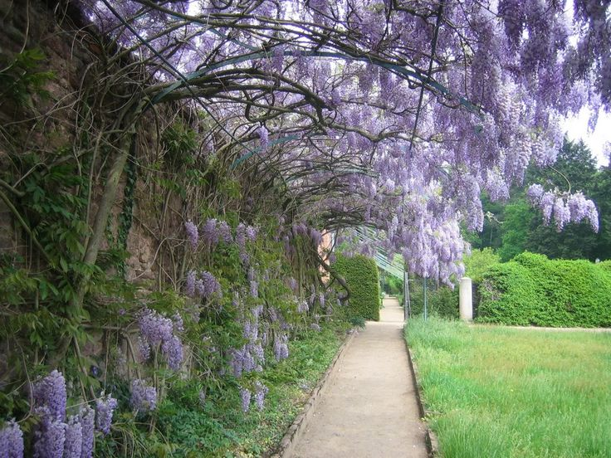
Shading & Albedo
Notes:
The second main way that plants affect the urban microclimate is through shading and increased albedo. Shading is really a no-brainer, but how much value is given to it?

Slide 19
Preventing light reaching a surface and heating it up
Or
Reflecting light from a surface to prevent it heating up
By 2030
Summer temperature will increase by 3-4 °C
Summer solar radiation will increase by 15-20%
(Williams et al. 2013. Based on Oxford, Bristol & Stockport)
By 2050
Summer temperature will increase by 4-5 °C
Summer solar radiation will increase by 20-23%
(Williams et al. 2013. Based on Oxford, Bristol & Stockport)
Notes:
These two mechanisms are really very straight forward. Approximately 1.3 KW/M² of radiant energy reaches the earth from the sun. If that radiant energy is causing you a problem (by heating you up/damaging your skin/eyes/building) then you have two choices. 1. Block it out by putting something in the way (shading). 2. Reflect it back into the atmosphere (albedo). Plants, in general are fond of radiant energy, they can harness it and use photosynthesis to turn it into energy they can use, so if you’re going to put something in the way, you might as well make it a plant and set up a lovely synergistic relationship. What’s more plants have in-built mechanisms to protect themselves from excess light, that is they can either transmit or reflect light when it gets too strong. Some plants are better at this that others, and it’s to do with their colour/albedo value. Note: Warming isn’t getting any better….we do need to think about how we handle it.

Slide 20
Using climate change projections, we see that the most effective methods for adapting existing English homes for climate change are likely to be:
User controlled shading
Increasing surface albedo
Exposure of thermal mass
Gupta and Gregg, 2012. Building and Environment (55). - IES Modelling.
Notes:
Prof. Rajat Gupta and colleagues have produced a number of studies using modelling to predict the effects of climate change on UK properties (and in particular, care homes). Shading and albedo are their top two prevention strategies for UK homes to adapt to the challenges of climate change. They note that low cost, retrofittable solutions are key to effecting change. Growing plants on and near buildings certainly meets these criteria.

Slide 21
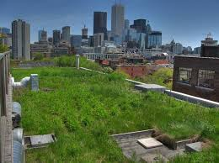
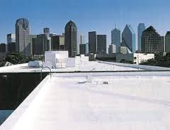
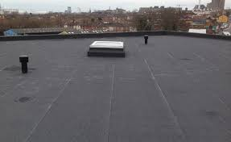
© Southampton Roofers
Toronto, CA © theconversation.com
© BerkeleyProducts.com
0
100
Bitumen
0.03-0.18
Coloured paint
0.15 – 0.35
Grass
0.4 – 0.5
White paint/Cool
0.9
Solar Reflectance
(Solar Reflectance + Thermal Emittance = SRI)
Global effects of cool roofs could be in order of saving 150 Gtn CO_{2.} Or taking every car off the road for 50 yrs (Akbari et al. 2012). Large overestimate – but the point is well made!
Notes:
The albedo values of various surfaces. White roofs would be most effective, but their only benefit is reflectance. The performance of roof materials in this aspect is measured using SRI values, and these will be familiar to industry professionals.

Slide 22
Leaf area index, stomatal resistance, height, coverage and albedo can all contribute to reducing heat gain
Perennial planting results in loss of cover and greater heat gain in winter
Temperature below substrate can be 20°C lower than normal roof.
Copyright: Lindam Green Roofs
Notes:
Applying this to a green roof then; A green roof can only shade a surface or reflect light if it is green. Therefore plant performance and survival is a vital component of its ability to deliver these benefits. It is also advisable to think about the seasonality of growth since heat gain may not be desirable in the summer, but may actually be of benefit to reduce heating costs in the winter. If you have evergreen coverage then you gather one benefit only to lose out on another. Deciduous trees/shrubs and perennial species can offer the best of both. A green roof really can have a profound impact on the temperature of the roof surface, but the benefits of this need to be considered in the context of the individual building. Oftentimes the benefits are not ‘guaranteed’ so technological solutions are deployed as well as a green roof, negating the cost-benefit of the roof.

Slide 23
Notes:
Our Welsh cities are growing – we ought to be thinking about future proofing them, and making them nice places to live and work…..

Slide 24
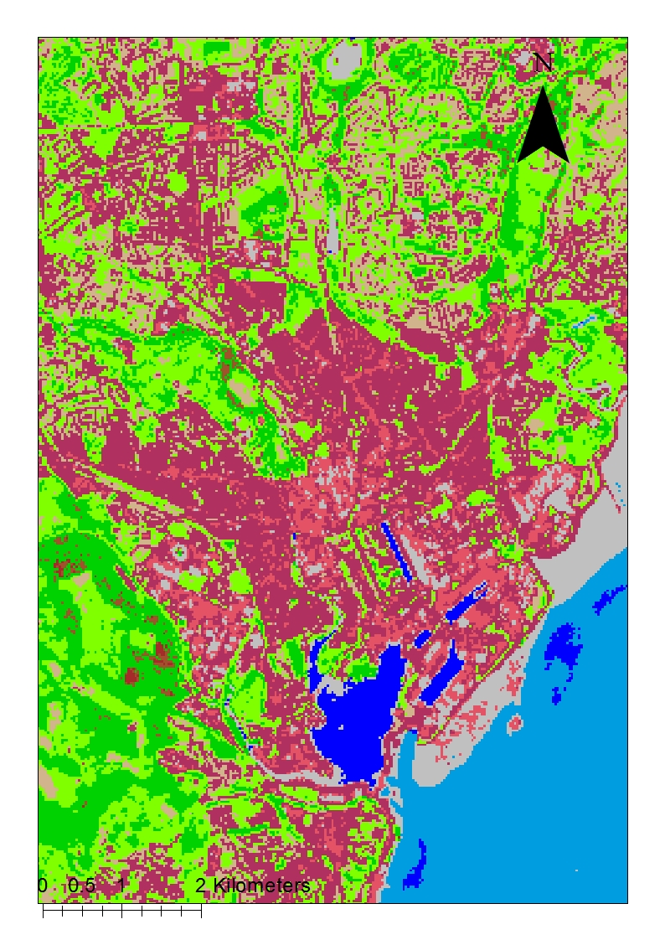
Land Cover Classification (Cardiff)
Notes:
Some modelling work that a student in our remote sensing department has been doing to think about how to judge the larger scale impacts of green infrastructure changes. The map above shows the first step – a land classification map for Cardiff. We were able to identify land classes with a good level of accuracy, although this has yet to be ground-truthed.

Slide 25
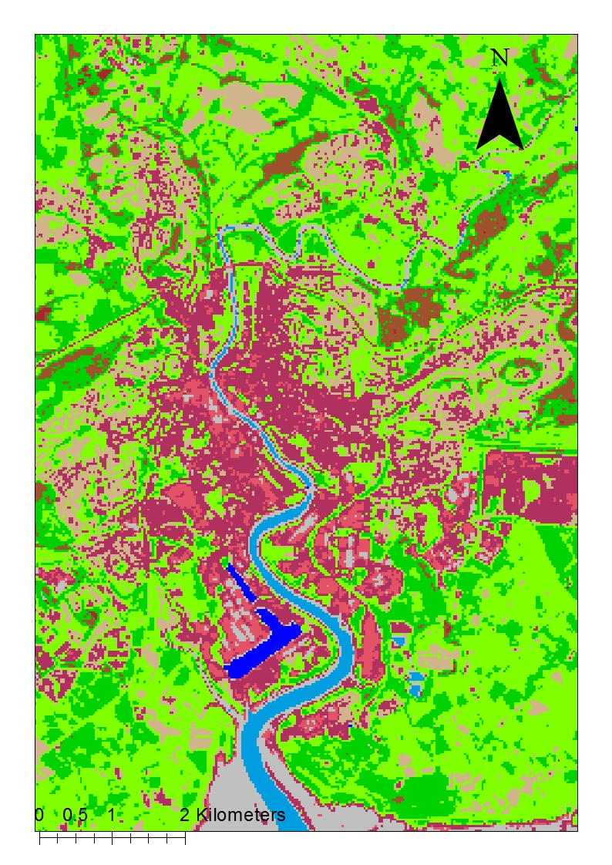
Land Cover Classification (Newport)
Notes:
A similar land classification map for Newport – on which little mapping work has been published (to our knowledge!) – If anyone has any, we’d love to see it!

Slide 26
Impervious surface mapping (Newport)
Notes:
After land classification we started to experiment with mapping impervious surface, since this has the greatest impact on thermal mass and on flooding risk. We have got good separation and want to develop this method further to target areas where surface permeability alterations could have the greatest impact.

Slide 27
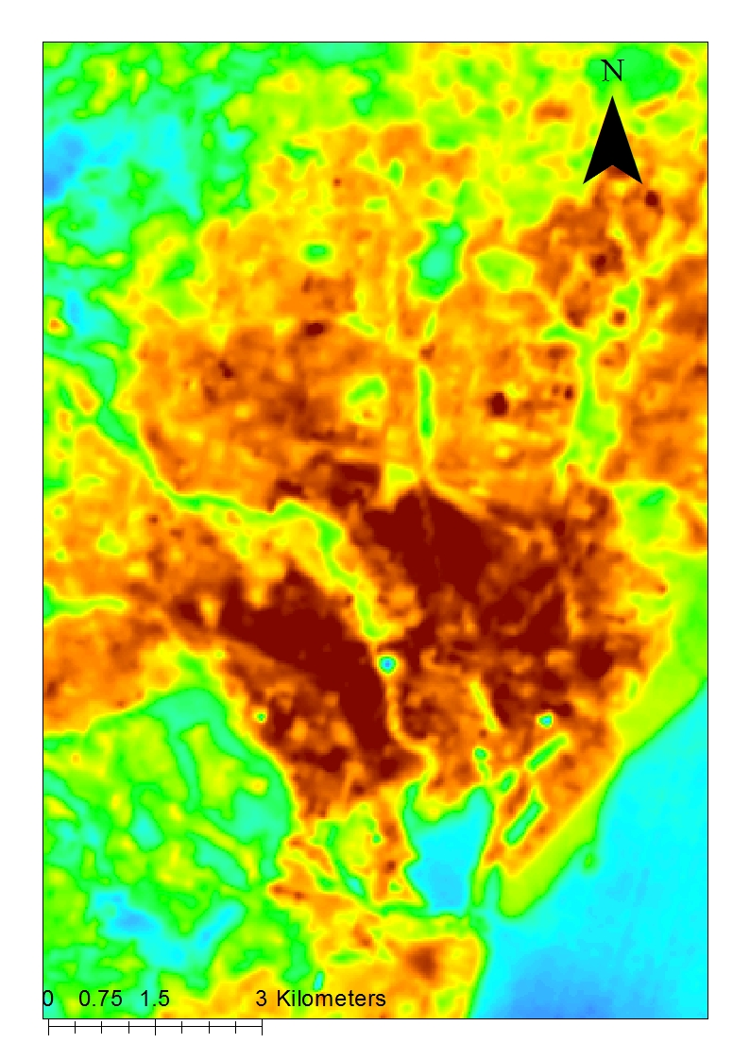
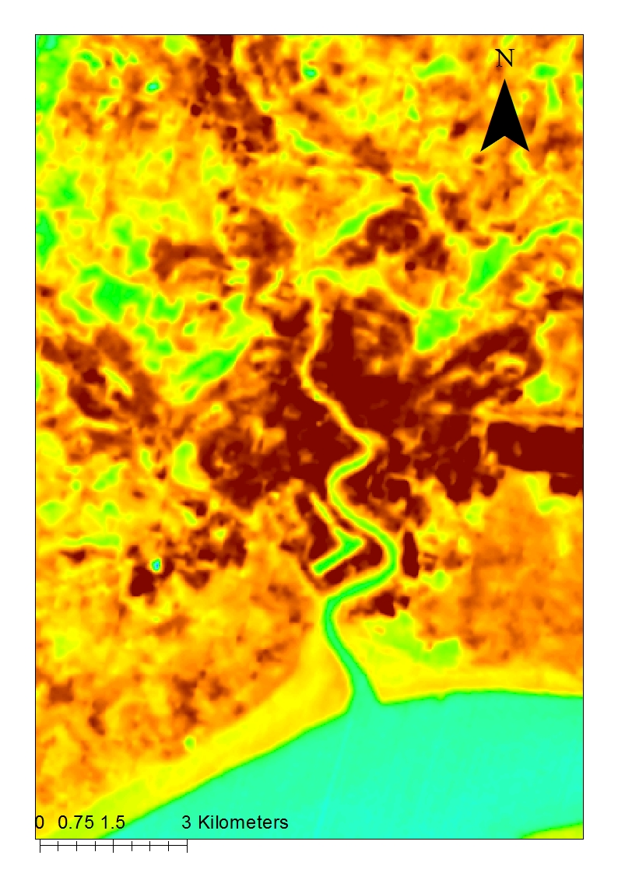
Land Surface Temperature - Cardiff (Degrees Celsius)
Land Surface Temperature - Newport (Degrees Celsius)
Notes:
After impervious surface mapping, we have added a layer of land surface temperature mapping. Our aim is that these layers can be built up to allow us to identify early intervention zones.

Slide 28
Air Pollution
Particulates & ROS
CO₂
O₂
Heavy Metals
Carbon Storage
Notes:
The final way that plants (particularly on-building) can affect urban microclimate is through air pollution mitigation. The diagram above represents the ‘best case’ scenario for green infrastructure and air pollution. Sometimes we can assume that this is the case, when in fact it is not quite so simple!

Slide 29
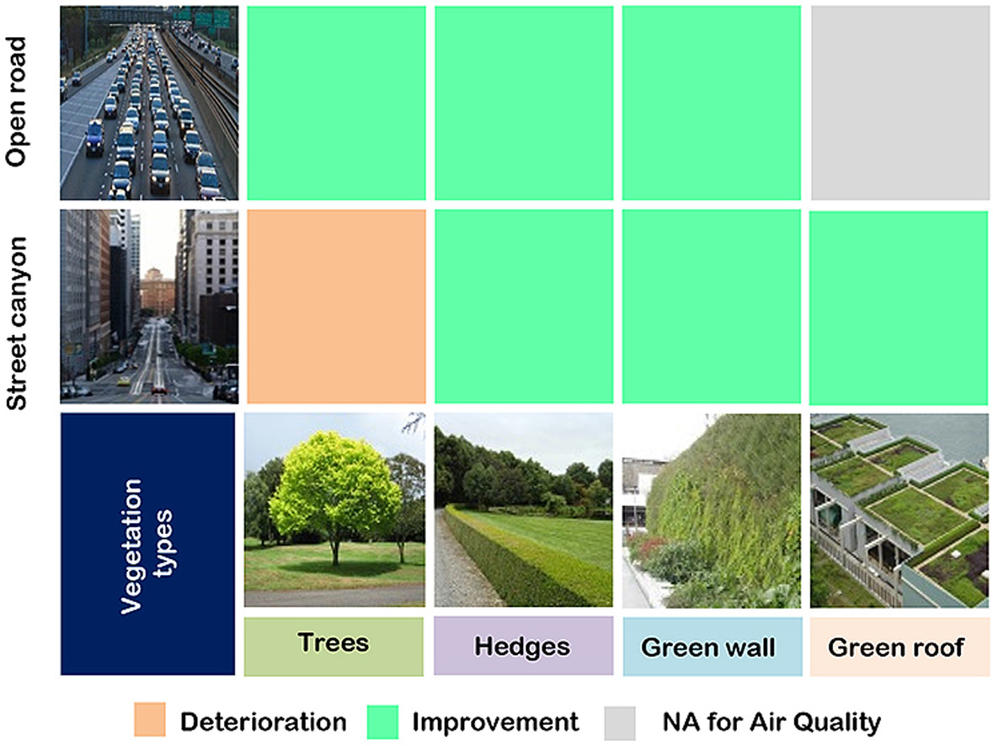
Reproduced from Abhijith et al., 2017
Notes:
This schematic diagram shows the results of a meta analysis on the benefits of certain types of green infrastructures installed in different urban typographies. It is worth noting that this doesn’t mean that all street trees have a negative impact, but does mean that certain trees, in certain streets may actually make pollution worse. It’s another call for thinking carefully about the function that something green is performing, and selecting species and maintenance regimes appropriately.

Slide 30
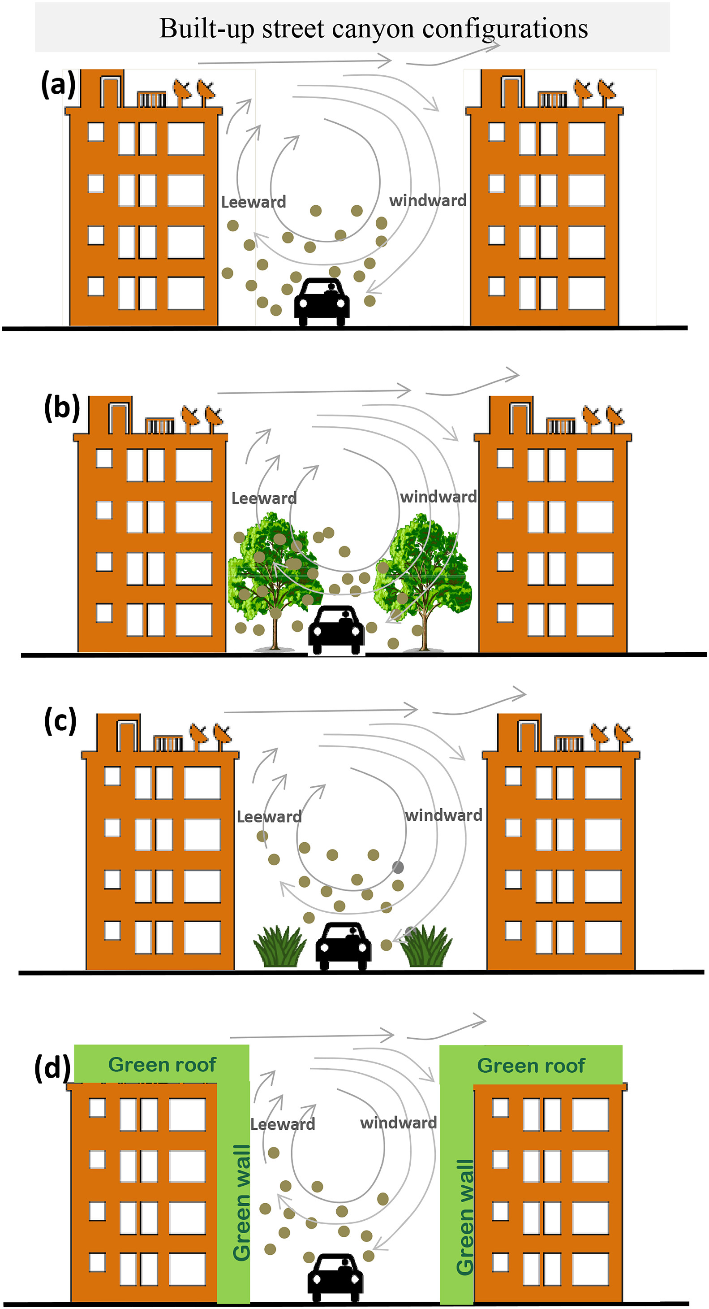
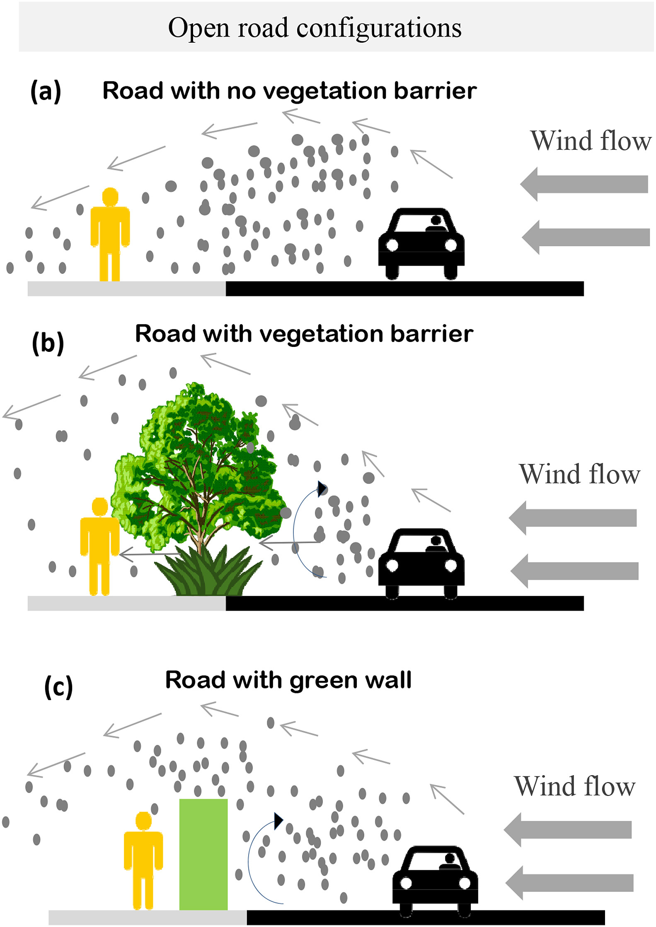
Reproduced from Abhijith et al., 2017
Notes:
These diagrams review the way that different types of greenery interact with pollution (particularly particulate matter) in two different common urban typographies. Obviously most streets are different from one another, and context is king, but it gives some guidance on how to think about where greenery is placed and how it will interact with particulate pollution. If even these simple principles were applied in our cities in would lead to a radical re-design of a number of public places.

Slide 31
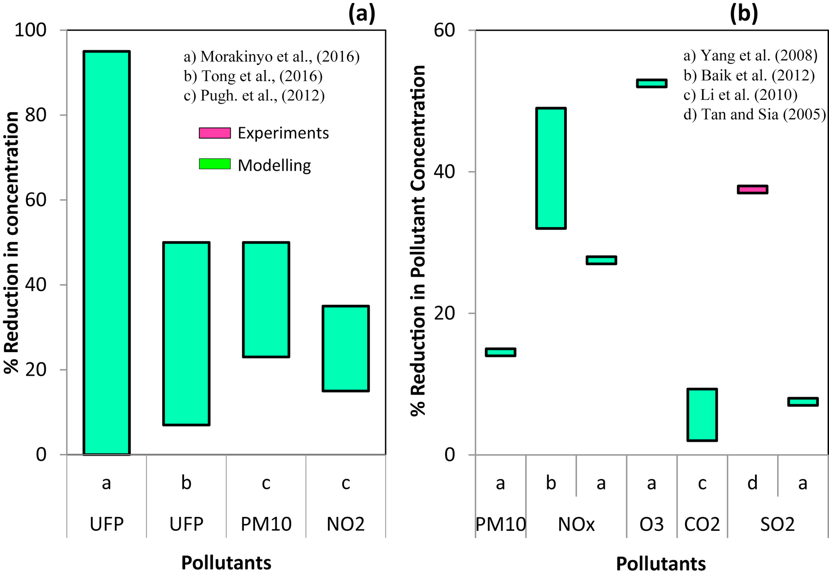
Green wall vs. no green wall
Green roof vs. no green roof
Notes:
The graphs in this slide show the net benefit of green roofs and walls against different types of pollution. Note that most of this data is from modelling, there are still very few experimental studies to demonstrate these effects. This is largely because any experiment is necessarily confined to the context in which it is conducted. We would need a large network of sites, all collecting data simultaneously to be able to make general conclusions about the impacts of these types of green infrastructure on air pollution, or any other function for that matter. If we want numbers, we need to start collecting numbers, and we need to do it in a big way, with co-operation, investment, and scientific rigour.

Slide 32
Questions to answer (collectively)
Ecology as amenity?
Retrofit?
1 in 5 live here (World Bank, 2014)
Multiple benefits?
Cost effective?
Health?
Asset?
Data?
Are we confusing the two? By focussing on amenity do we lose sight of the value of our ecology?
Quite a few people are going to be living in cities, how do we make them future proof?
How do we capture more than one benefit when we value greenery. When we can, green solutions may suddenly start to seem much more cost effective.
How important is green space for our physical and mental health? The latest research suggests that green space could have a profound impact.
Green spaces are assets, and we need to give them a value that reflects this, this needs to extent to all, not just historic spaces.
As a society, we like numbers, so we need to generate some.
Notes:
In the last slide of this presentation, I just put some words up that represent issues which we are yet to solve, in this final version I’ve annotated slightly to help with meaning. I’ve also decided to add ‘data’ because there is a dearth of reliable data upon which to draw firm conclusions, and I’m determined to try and generate more! Thank you for listening to me, and I look forward to working with you to improve ‘in the words of Nick Grayson’ the liveability of our future cities.

Slide 33
Thank you.
pcw1@aber.ac.uk
@PlantsArchitect
NRN Plants and Architecture project
Financial support provided by the Welsh Government and Higher Education Funding Council for Wales through the Sêr Cymru National Research Network for Low Carbon, Energy and Environment

