Slide 1
State of Natural Resources Report
Ruth Jenkins

Slide 2
Sustainable management of natural resources
Area Statements are an integrated evidence base, setting out the risks, priorities and opportunities at a local level to facilitate the implementation of the NNRP at a local level.
Produced by NRW.
Collaboration opportunities for different bodies to work together in the delivery of SMNR
Rationalise plans
State of Natural Resources Report
(SoNaRR)
The State of Natural Resources Report (SoNaRR), produced by NRW, will report on the status of Wales’ natural resources and track the progress being made towards achieving the sustainable management of natural resources. It will also serve as an essential evidence base to underpin the NNRP.
Area Statements
National Natural Resource Policy (NNRP)
The National Natural Resource Policy will set out the priorities for the sustainable management of natural resources at a national level. It will outline how the sustainable management of Wales’ natural resources will provide benefits to society and the economy as well as the environment, supporting the goals outlined in the Wellbeing of Future Generations (Wales) Act.
Notes:
Key Messages
This Act puts in place this delivery framework for SMNR.
It applies the adaptive management approach at the national scale.

Slide 3

Next Steps
Natural Resources Policy Statement
SA
start up
SSE consultation
NNRP SA appraisal
Timeline
July 16
July 15
Oct 15
Jan 15
Apr 16
Oct 16
Jan 16
Q1-2 17
Internal and external engagement on NNRP development,
and guidance
NNRP options development
Consultation Oct 16
Publish
Guidance
SoNaRR Evidence gathering and assessment of SMNR
Publication Sept 16
Joint NRW/WG Core NRM Evidence Group

Slide 4
What does SoNaRR need to report on?
  Section 8 of the Environment Bill sets out 2 tasks for SoNaRR:
    an assessment of the state of our natural resources, and
    the extent to which the sustainable management of natural resources is being achieved
  The Sustainable Management of Natural Resources means managing natural resources sustainably ‘to maintain and enhance the resilience of ecosystems and the benefits they provide…’
1
2
Notes:
The Environment Bill essentially focuses on three elements
Resilient functioning ecosystems
Understanding the benefits package supplied from our natural resources
Possible response in the form of policy and management mechanisms

Slide 5
Which means…
1
    an assessment of the state of our natural resources
    – looking at environmental status & drivers of change, highlighting the risks to the resilience of ecosystems and the impact on wellbeing
    the extent to which the sustainable management of natural resources is being achieved
    – looking at human management of the environment, land use, pollution and waste management, resource efficiency
2
Notes:
SONRR will provide policy relevant (policy ready) information on ecosystems
It will set out key challenges and potential solutions to achieving the Sustainable Management of NR-Essentially an analysis of evidence for informing policy and management interventions
Important here that it’s recognised with no. 2 that Sustainable management has a wide definition – includes use of our natural resources, addressing pressures on them, and positive actions
This is effectively the difference in old style reporting where reports observed the outcomes of impacts and reported on status. This style of reporting has not made the connections between people and ecosystem resilience and has not lead to appropriate societal response (impacts on society were not explicitly linked to the state of the environment)
UN Convention on biodiversity set out the shortcomings of this approach and set out the benefits of a systems approach (ecosystems approach) by widening environmental reporting to include socio-economic interactions.

Slide 6
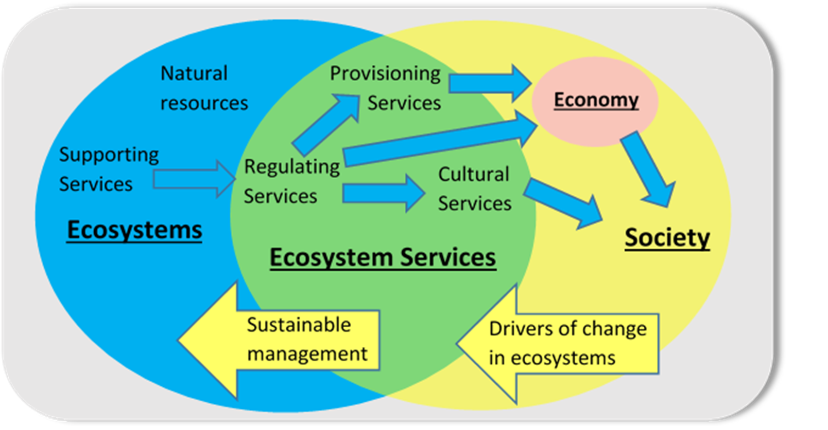
The Ecosystem Approach
2
1
Notes:
By Taking an ecosystem approach SONARR will consider the interconnectivity and relationships between Social/Economic and Environmental systems
This is complex stuff where the flows between these systems are often managed as if they were separate and not interconnected.
Capturing information and understanding these complex interactions helps if we look at Drivers and pressures Status , Impact on Wellbeing (benefits) and the required response.
Is about looking at the state of natural resources to identify threats to resilience from drivers of change ( eg over use, pollution, climate change, alien species)
Is about what we need to do in terms of human activity to stop running down our stock of natural resources and ensuring ecosystems are resilient to change

Slide 7




Socio-ecological Systems
Policy responses
Society
Drivers of change
Ecosystem services
Environment
Environmental pressures
State of environment
Adapted from: OECD / European Environment Agency/ UNEP
Notes:
Systems approach, don’t stop with focus on biodiversity and state of environ, but follow through and show effects on human wellbeing, and also look at drivers behind pressures
Drivers are the underlying causes of change in ecosystems. They are exogenous to the ecosystem and are described using narrative storylines.
Pressures are the variables that quantify the relevant drivers. They are endogenous to the ecosystem and are represented in scenarios.

Slide 8
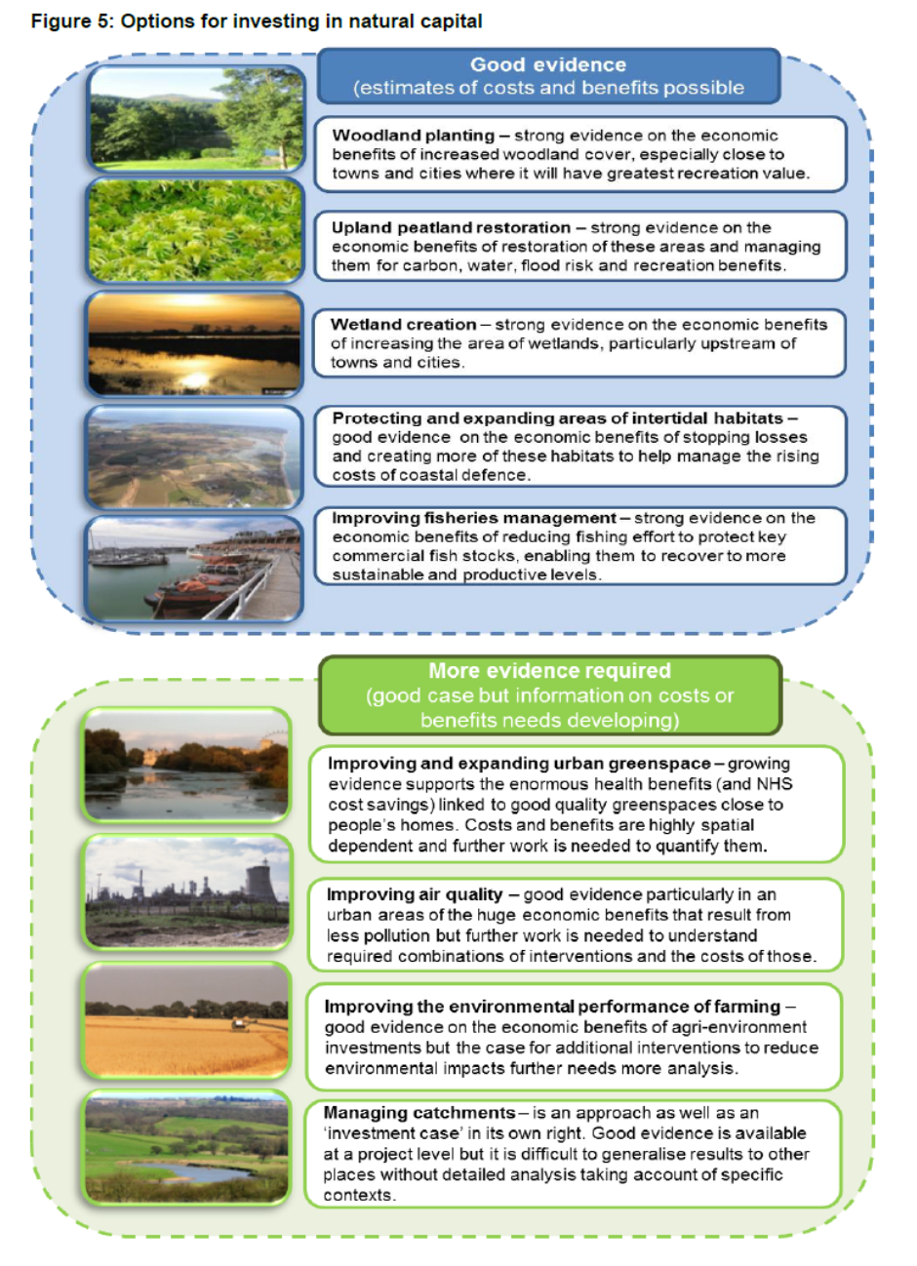
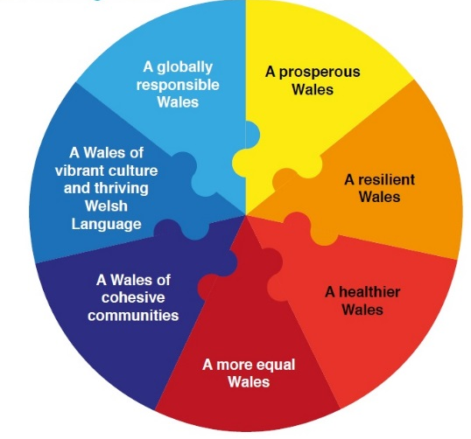
For example... NCC Work (England) and Well-being Goals
  From challenges:
    Economy
    Poverty
    Climate change and biodiversity
    Public Health
    Equality
    Skills and education
  To opportunities:
    Green growth
    Green tourism
    Nature based solutions to public
    health issues and urban planning
    Circular economy
    Resource efficiency
    Low carbon energy

Slide 9
State of Natural Resources Report
Notes:
Nat res, Ecosystems, Drivers of change
This is how the chapters will work

Slide 10
SoNaRR Chapter Title

Slide 11
An assessment of the extent to which SMNR is being achieved:
Chapter 8 SMNR
  Measures of management: How we use natural resources and how our activities impact on our natural resources (for example resource efficiency and regulation –and, positive actions such as restoring habitats and improving connectivity.
  Measures of pressures and state: The extent to which how we are currently managing our natural resources is impacting on the health of our ecosystems
  Measures of risk: What are the opportunities and priorities for managing our natural resources sustainably
  Measures of benefits vs cost of actions: Where are the priorities, opportunities and risks to the benefits ? What is the rationale?

Slide 12
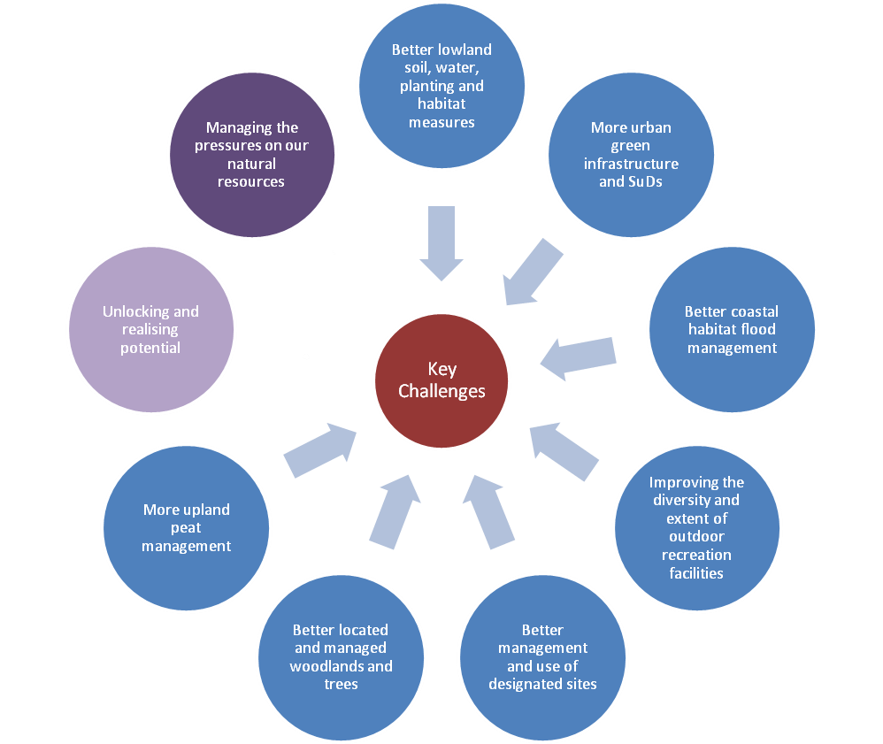
Example priorities... Welsh Government’s Natural Resources Policy Statement
Safeguarding and increasing our carbon stores
Maintaining our productive capacity
Reducing the risk of flooding
Improving health and equity
Improving the quality and maintaining the availability of water
Improving the quality and connectivity of our habitats
Key challenges
Retaining the distinctiveness of our places and historic landscapes
Notes:
Applying the principles of SMNR:
This diagram shows how the interventions proposed address across the key challenges and provide multiple benefits.
For example, more upland peat management will reduce flood risk, improve health, increase carbon stores etc.
The also:
Consider (build) ecosystem resilience.

Slide 13
Example priorities... Welsh Government’s Natural Resources Policy Statement
Safeguarding and increasing
our carbon stores
A loss of carbon storage in soils – especially our peat rich uplands – and in biomass particularly where woodland is permanently removed is potentially diminishing our ability to regulate our climate.
Changing land management practices, urbanisation, pollution and invasive non native species have led to habitat loss and fragmentation, which, coupled with acidification and eutrophication have changed the quantity and quality of wildlife they can support.
Improving the quality and
connectivity of our habitats
In Wales, there is a high dependency on our rivers for our water supply. Diffuse and point source pollution from a range of sources including some land management practices, sewage discharges, abandoned mines and misconnected sewers is affecting our water quality.
Improving the quality and
maintaining the availability of water
Noise, poor air quality and flytipping are impacting on our health. Lack of access to good quality green or blue space reduces individual well-being and can affect mental health. These impacts are disproportionately experienced in poorer urban areas.
Improving health and equity
Increased soil sealing and compaction from farming practices and urban development resulting in loss of water storage capacity and more surface water run-off. The loss of natural coastal flood defences is a key challenge.
Reducing the risk of flooding
Loss of soils and reducing soil quality, threats to pollinators and our plant health and from invasive non-native species risk the productive capacity of our land for food, timber and fibre; including for energy.
Maintaining our productive capacity
Retaining the distinctiveness of our places and historic landscapes
Wales is renowned for its attractive and historic landscapes. During the mid-20th Century the character of the landscape was impacted by developments relating to energy, transport and tourism and through forest design.
Notes:
What does Wales need to do to build ecosystem resilience and secure wellbeing benefits now and in the future?

