Slide 1


Step it up – Marketing the
Wales Coast Path:
Writing a promotional poster

Slide 2
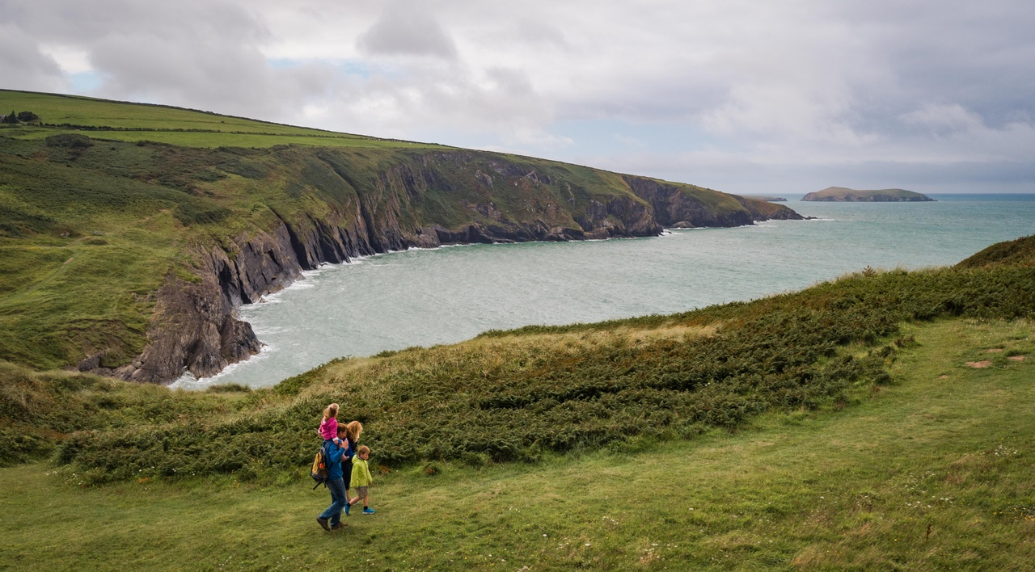
Background - What is the Wales Coast Path?
An 870-mile-long continuous coastal footpath which stretches along the entire length of the Welsh coastline.
The whole path is accessible to walkers, with some sections suitable for cyclists, families with pushchairs, people with restricted mobility, and horse riders.

Slide 3
What is marketing?
Working in small groups, discuss and write down:
• What to do you understand by the term ‘marketing’?
• What does marketing do?
• Why do people use marketing?
• Who uses marketing? Can you think of any companies or organisations that market their products?
• When do things get marketed?
• What are the pros and cons of marketing for an organisation?

Slide 4

What is marketing?
Marketing is about making sure the right people know about what you have to offer, getting them to come to you and getting them to buy or buy into what you have to offer.

Slide 5

Your brief
Imagine you are marketing experts.
Your client Natural Resources Wales (NRW),
would like your help to plan and prepare a promotional poster for the Wales Coast Path to encourage people to visit.
Your poster will be placed in various locations across Wales as well as being shared online and on social media.

Slide 6
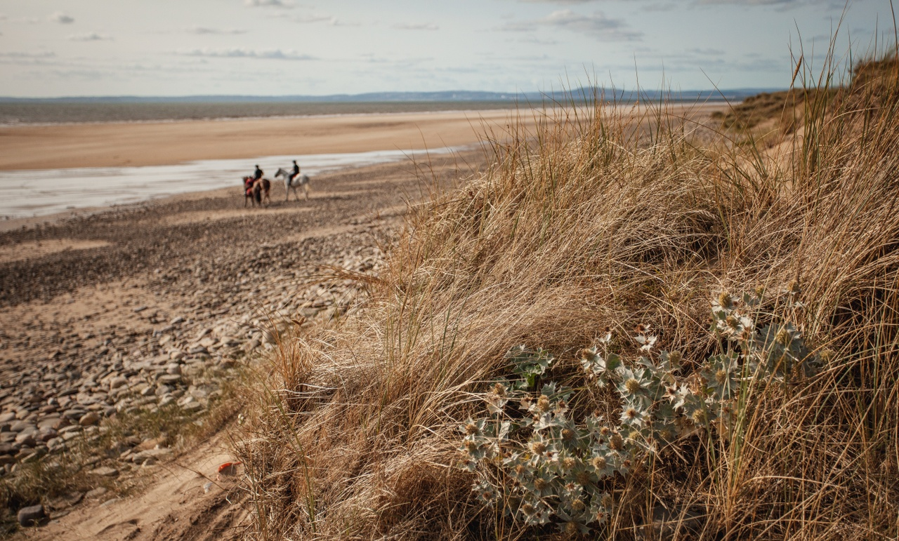
Task
Working in small groups:
Consider, is there a section of the path your group would like to promote?
Or will you make a poster to promote the Wales Coast Path in general?

Slide 7

Discuss: What are the pros and cons of a promotional poster?

Slide 8

Background information
What do you know about the client?
Understanding your client’s business is critical to ensuring the success of your marketing campaign.
What does your group know about Natural Resources Wales?
What does the organisation do?
How many staff does the organisation employ?
What are its roles and responsibilities?
What is its role in the Wales Coast path?
Click the icon to watch a short video about what NRW does

Slide 9
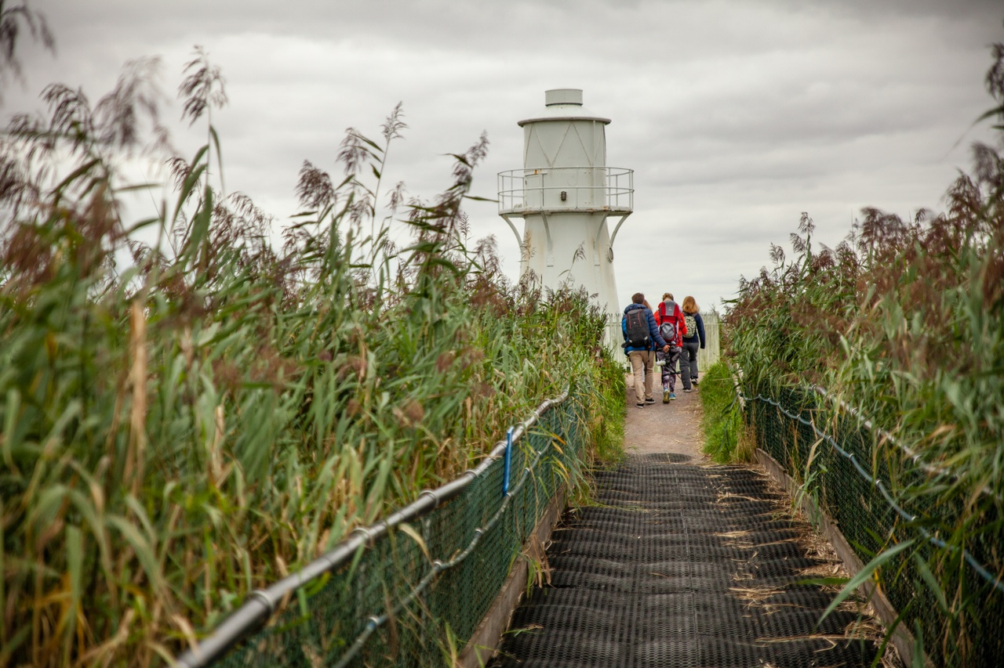
What do you know about the Wales Coast Path?
Complete some research into the history and significance of your chosen section of the Wales Coast Path.

Slide 10
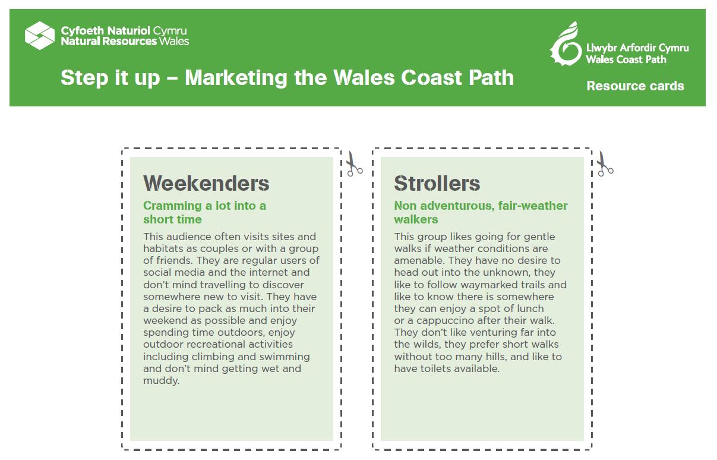
Identify who’s the target audience?
A target audience is the specific group of people you want to reach with your marketing materials. They are the people who are most likely to be interested in your content.

Slide 11
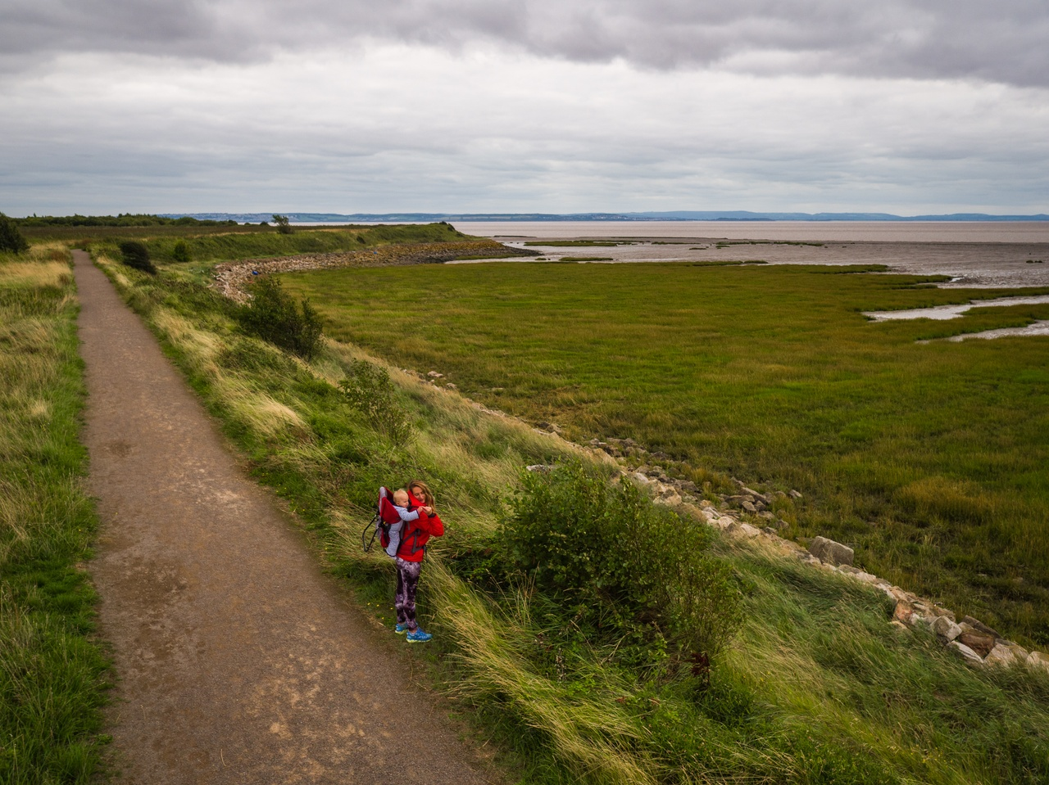
If you are visiting the Wales Coast Path…
…there may be opportunities to carry out some market research and on-site investigations
What are your first impressions of the Wales Coast Path? Note your observations.
Can you create a word cloud to capture the unique selling points of the Path?
Can you prepare a questionnaire to get insights into why people visit the Path?

Slide 12
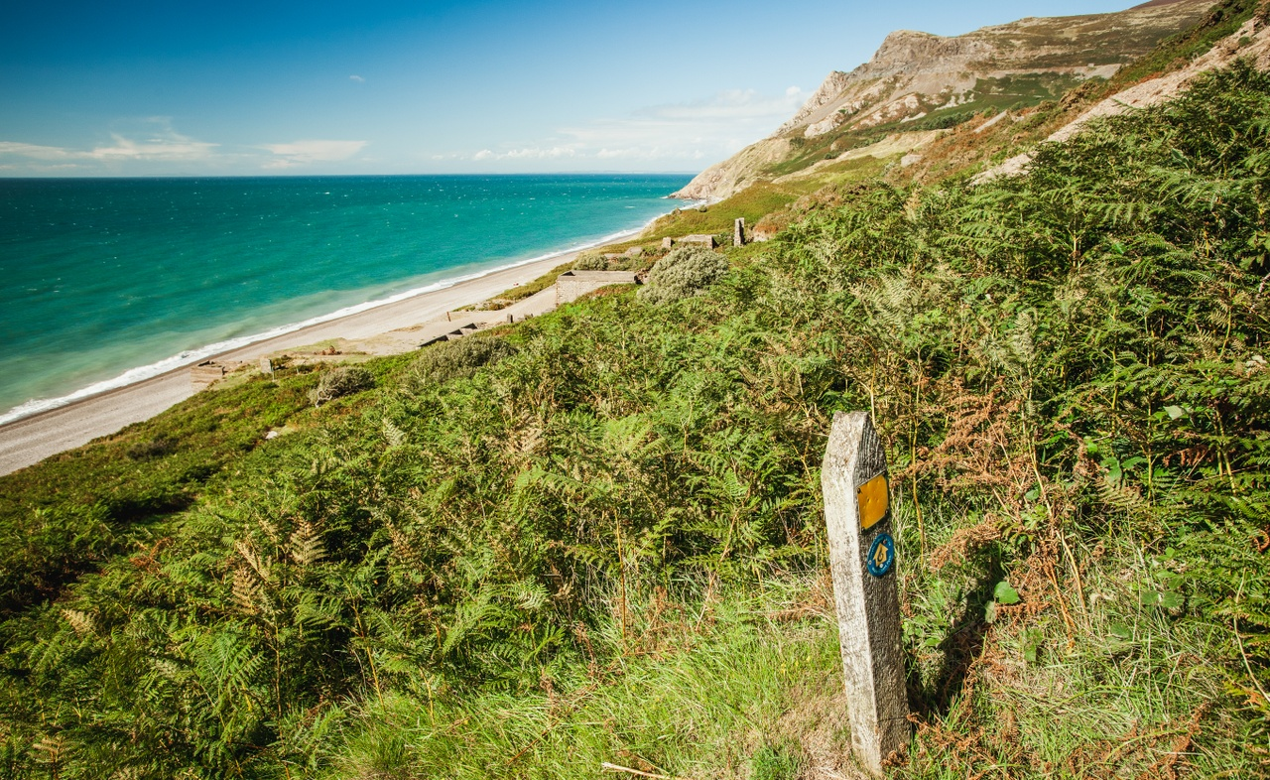
If you are visiting the Wales Coast Path…
…there may be opportunities to carry out some market research and on-site investigations
Create a simple data collection sheet to record the number of users visiting the given stretch of path.
Take photos – these might feature on your poster!

Slide 13

Planning and sharing ideas for your promotional poster
What are the unique selling points of your chosen section of the Wales Coast Path?
People who work in the marketing industry talk about the Unique Selling Point (USP) – the thing which makes their offer different and/or better than others.
What are the unique selling points of the Wales Coast Path that you want to promote to your target audience? Note your ideas.
How will you communicate them?

Slide 14

Sharing your initial ideas with the client
Get feedback and approval from the client before pressing ahead with your ideas.
You could pitch your ideas to the ‘client’ in the form of a:
• Group presentation – using Microsoft PowerPoint or Google Slides.
• Two-minute group talk – explaining your main ideas and thoughts on the direction the promotional leaflet should take.
• Create a mood board - A mood board is a digital or physical, pictorial collage of ideas.

Slide 15

Set SMART objectives for the designing of your promotional poster
Make sure your objectives are:
    S – Specific
    M – Measurable
    A – Achievable
    R – Relevant
    T – Time bound

Slide 16
Set SMART objectives for the designing of your promotional poster
Make sure your objectives are:
S – Specific e.g. We want to create promotional poster to raise awareness of the wildlife along the Wales Coast Path.
M – Measurable e.g. we want to increase the number of visitors to the Wales Coast Path by 5%.
A – Achievable There’s no point trying to increase the number of visitors to the Wales Coast Path by 2 million people if you only have 3 weeks to achieve this. Although it’s a great aim, it would be very hard to achieve.

Slide 17
Set SMART objectives for the designing of your promotional poster
Make sure your objectives are:
R – Relevant The whole purpose of your promotional poster is to increase awareness and use of the Wales Coast Path. If your poster ends up raising awareness of a new garage that has opened in the area, then it’s not relevant!
T – Time bound Is what you plan to put in your poster feasible in the time you have available? Set deadlines to complete tasks by, this will help you prioritise and reduce the risk of you becoming overwhelmed.

Slide 18
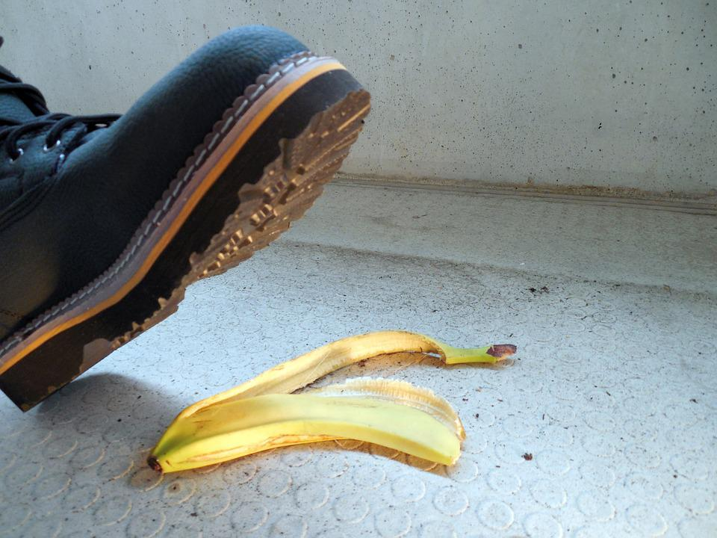
Risks/Challenges
Planning and creating a promotional poster may not appear to involve much risk, but thinking about risk is integral to communication.
Consider:
What could go wrong when you send you put up your promotional poster?
2. What is the likelihood and impact of something going wrong?
3. What can you do to minimise the risk?

Slide 19

Creating your Wales Coast Path promotional poster
Posters:
Are a great way to promote a site or habitat.
Allow you to share your message in a creative and fun way.
Great resource to attract and engage potential path users.
Can be created digitally or manually.
Offer an opportunity for you to be creative.

Slide 20

What lessons can you learn?
As a group, look at a range of promotional posters and scrutinise them.
What are the pros and cons of each poster?
What lessons learnt can you carry over to your own poster?

Slide 21
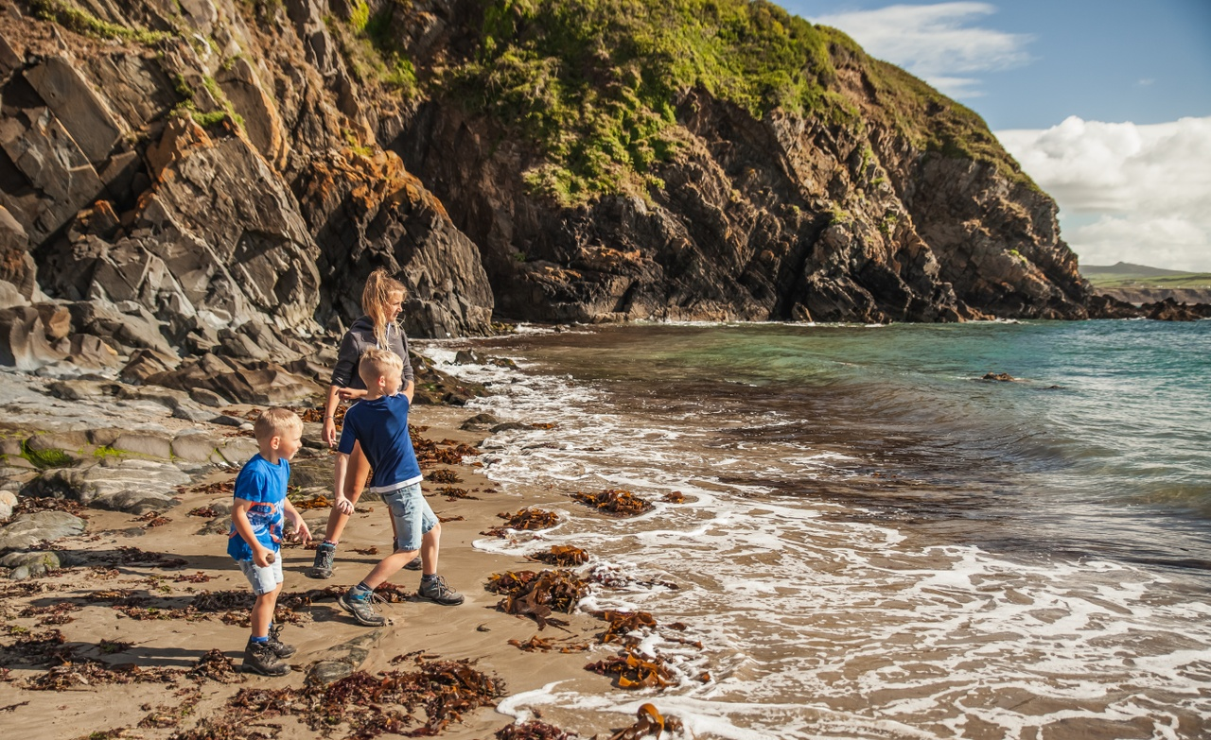
A poster should…
Hold the readers attention
Be visually attractive
Offer something new idea/angle on the subject matter
Be exciting or amusing
Achieve the objectives set at the start

Slide 22

When designing your poster make sure:
You think about size and location
Where will your poster be displayed? Will it be A3 or A4 sized?
Ensure that your poster is eye catching
People should be able to see it from a fair distance. The main purpose is to stand out.
That it’s clear what is being promoted
Can your audience work out what your content is about at a glance?

Slide 23

When designing your poster make sure:
Your poster won’t distress your reader’s retinas
Your poster needs to look professional and shouldn’t be a shower of colour. Stick to 3 to 5 colours in your colour palette.
You keep words to a minimum
A block of text will be too much for your reader. Your poster should include just enough information to get the main message across.

Slide 24

When designing your poster make sure:
Keep it clean and simple
Less is more. A busy poster can look cluttered and be harder to read. A clean design is timeless and makes it easier to digest information. It’s ok to have some blank space.
The poster is branded and includes relevant logos
Who’s been involved? Acknowledges partners. Do any logos need to be included?

Slide 25

When designing your poster make sure:
You make it easy for users to get in touch
How do users get in touch if they want to find out more?
Include a call to action
After reading the poster, what do you want the reader to do? Let the audience know: ‘Book today!’, ‘Refill here’ or ‘Visit soon!’

Slide 26
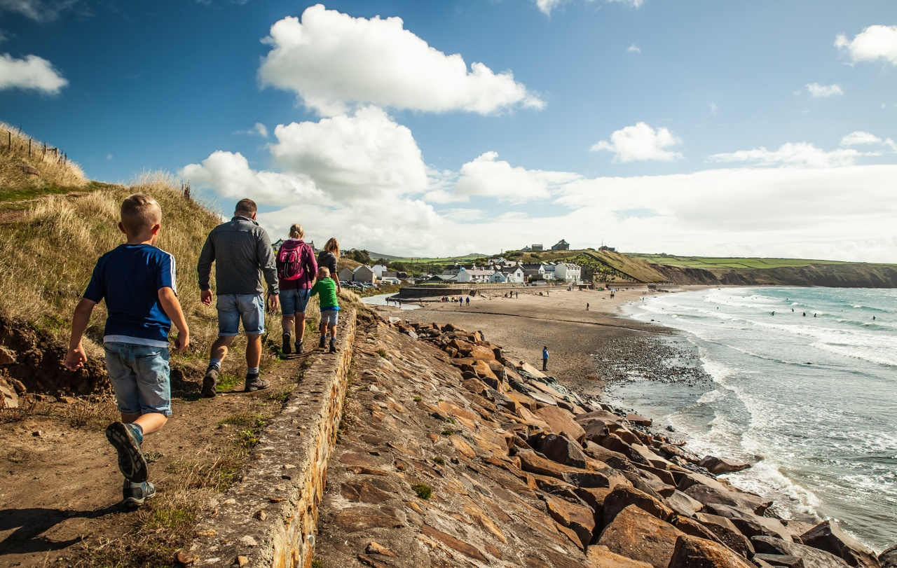
Choosing the right images
When choosing images for your promotional poster consider:
Do the images help the user understand the point you are trying to make?
Do the images speak to your target audience? For example, if targeting families, a picture of a family out walking will be best.
Do the images create emotional appeal? Do they encourage the reader to visit the site and walk along the beach for themselves?
High-res images are a must!

Slide 27
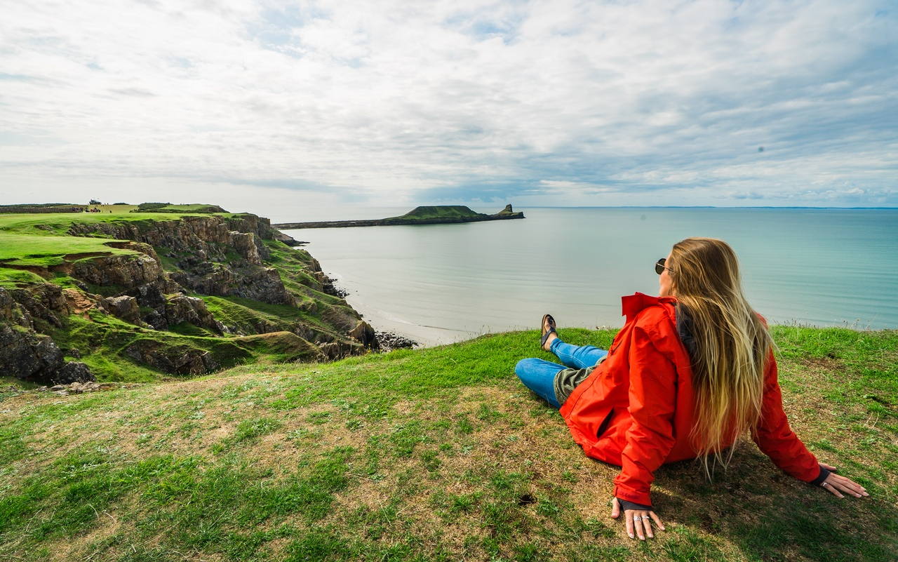
Identifying success
How will your know if your promotional poster has made an impact and if you’ve met the ‘client’s’ brief?

Slide 28
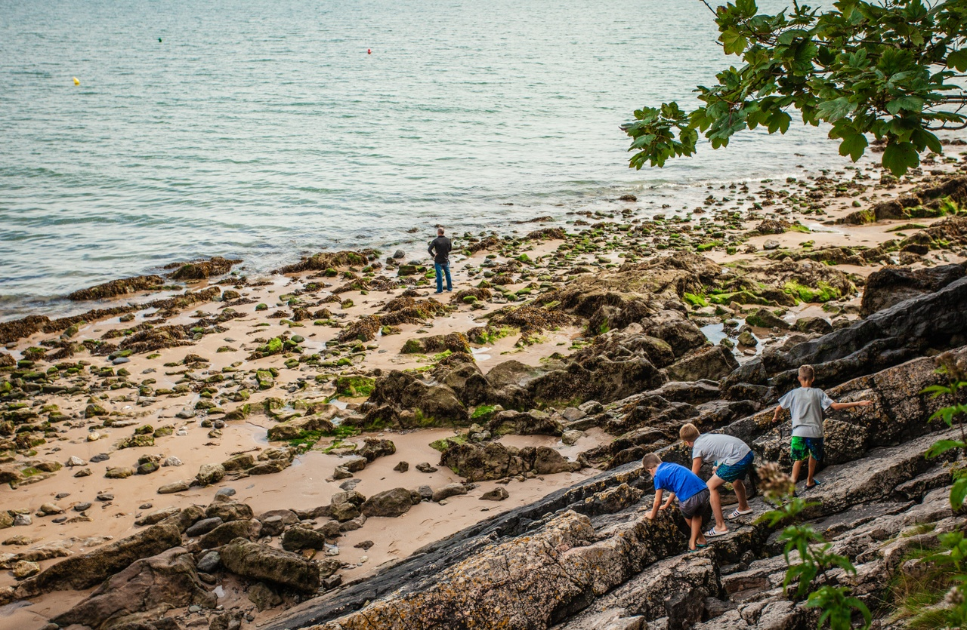
Lessons learnt
What were your group’s successes and weaknesses?
What steps can you take next time to ensure things go more smoothly?

