Slide 1
Managing flood risk on the River Elwy
© Alun Williams

Slide 2
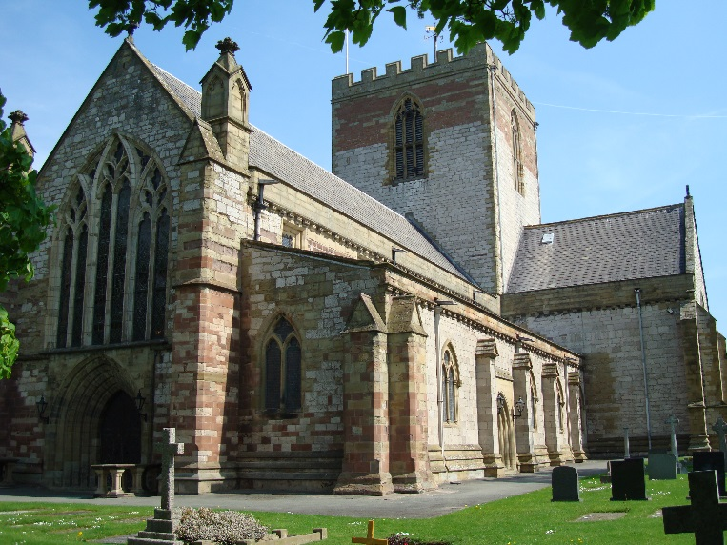
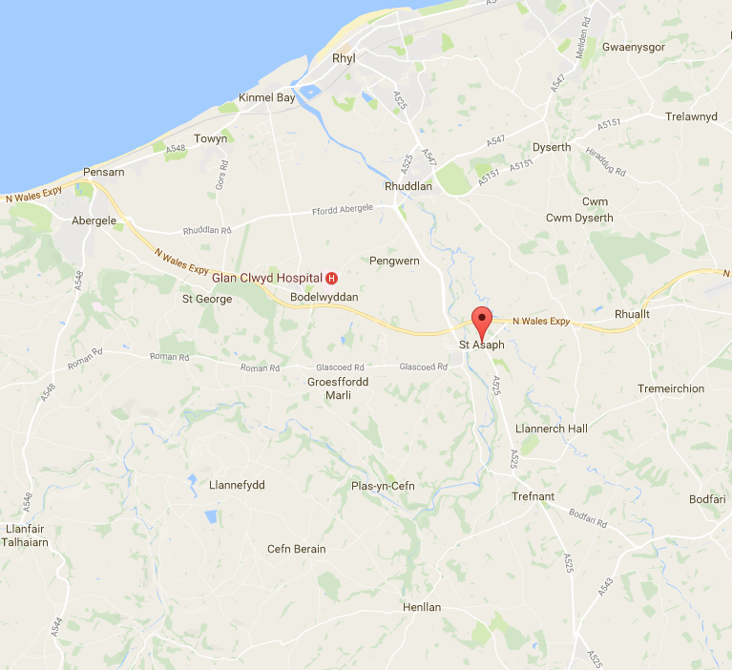
St. Asaph
Notes:
Awarded city status as part of the Queen's Diamond Jubilee celebrations in 2012, St Asaph is a small city in North Wales, situated in the Vale of Clwyd between Denbigh and the coastal resort of Rhyl. It is home to the smallest Cathedral in Britain and has a population of just under 3,500 according to the 2011 census. It is located on the lower reaches of the River Elwy.

Slide 3
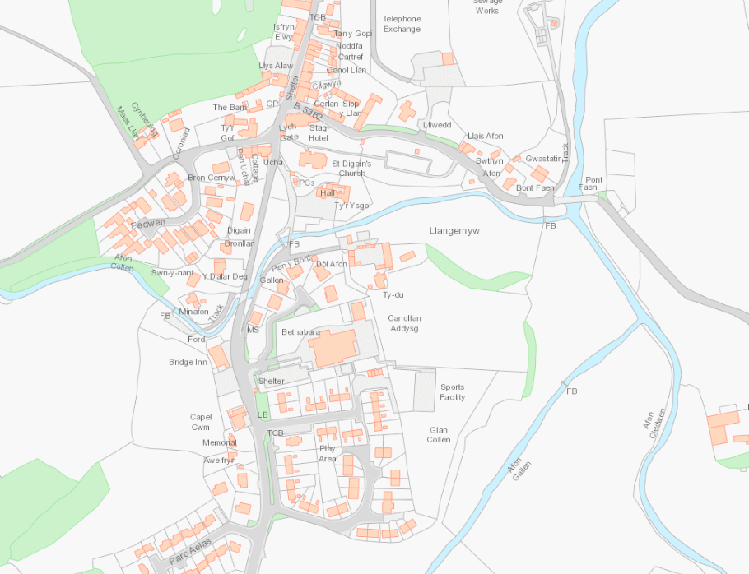
The Afon Elwy
Afon Elwy
Afon Collen
Map showing the Rivers Gallen, Collen and Cledwen converging at Llangernyw to form the River Elwy
Afon Gallen
Afon Cledwen
Notes:
The River Elwy, a tributary of the River Clwyd comes into existence in the village of Llangernyw (South-west of St. Asaph) as three rivers converge to form the Elwy – Afon Gallen, Afon Collen and the Afon Cleddwen.
From Llangernyw the Elwy flows easterly to Llanfair Talhairn where another tributary, Afon Aled joins the Elwy. After passing through Bont-Newydd, the Elwy turns northwards and flows through St. Asaph. Flowing directly through the city, the Elwy is a medium sized river with a catchment area of around 250km² when it reaches St. Asaph.

Slide 4
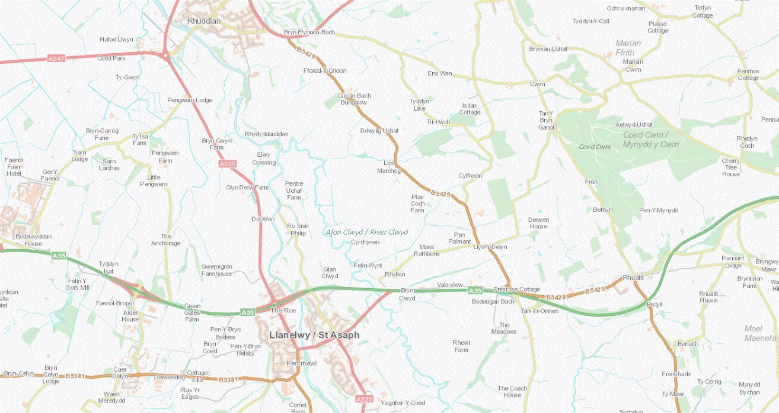
The Afon Elwy joins the Afon Clwyd
Map showing the confluence of the River Clwyd and Elwy
Afon Clwyd
Afon Elwy
Notes:
The Elwy has its confluence with the River Clwyd 1.8km downstream of St Asaph.

Slide 5
Historical flooding at St. Asaph – 1964/65 floods
Notes:
Flood risk to the city comes predominantly from raised water levels in the River Elwy overtopping the city’s flood defences.
Historically flooding has occurred in the city in 1871, 1882 and 1896. During the 20th century, flooding was reported during 1913, 1964 and 1965. This prompted construction of the original defences through the city in the 1960’s.
These defences were raised again during 1975. The defences withstood all flood events until the 27th November 2012.

Slide 6
November 2012 floods
Spring Gardens Caravan Park
Talardy Hotel
Flood extents and flow routes
St. Asaph park
Co-operative
New Inn pub
Notes:
The flooding in November 2012 occurred when prolonged, intense rainfall fell over the catchment. During the early hours of Tuesday the 27th November 2012, the defences were overwhelmed when the Elwy rose 3 metres above its normal level.

Slide 7
Footage of the St. Asaph floods
http://www.bbc.co.uk/news/uk-wales-20507168
2.26 minutes
BBC news
27th November 2012
Notes:
Aerial footage of St Asaph shows the extent of the flooding in the city as affected residents take shelter in a leisure centre.

Slide 8
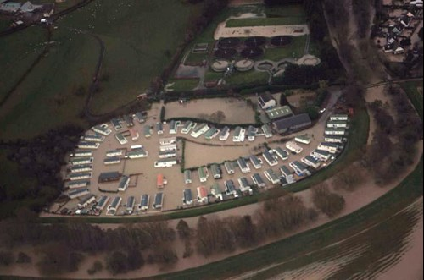
St. Asaph sewage works
Spring Gardens Caravan Park
Downstream of the A55
Notes:
Initial reports from site stated that flooding began to occur downstream of the A55 with water spilling into the Spring Gardens area.
This area was then cut off as upstream sections flooded. Out of bank water, was fast flowing and all areas affected were quickly inundated.

Slide 9
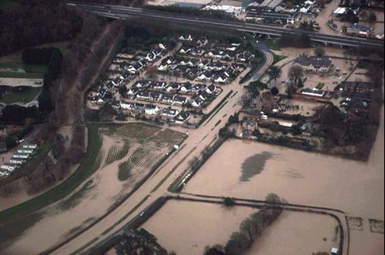
Downstream of the A55 –
Talardy Hotel
Roe Park housing estate
Notes:
322 homes, 32 businesses and 70 caravans within the city were flooded.

Slide 10
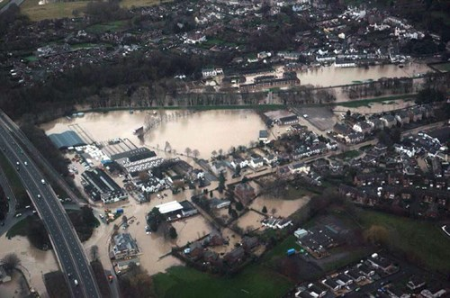
St. Asaph library
The Plough pub
Costcutter Service Station
Ysgol Esgob Morgan
Upstream of the A55
Notes:
A flood depth of 0.8 metres was recorded.

Slide 11
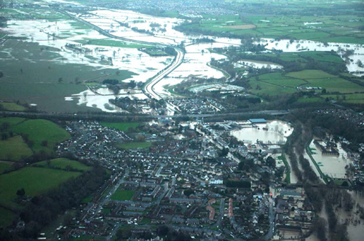
Photo highlighting the extent of the flooding at St. Asaph, looking downstream.
A55

Slide 12
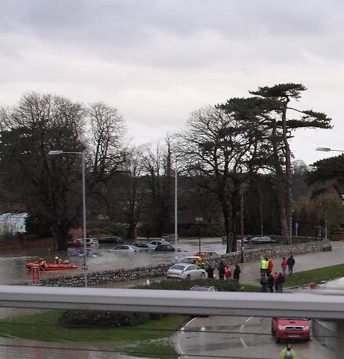
Flood damage
© Alun Williams
St. Asaph suffered damage to:
Residential and commercial properties
Vehicles
Roads
Schools
Notes:
One member of the general public sadly lost their life as a result of the floods.

Slide 13
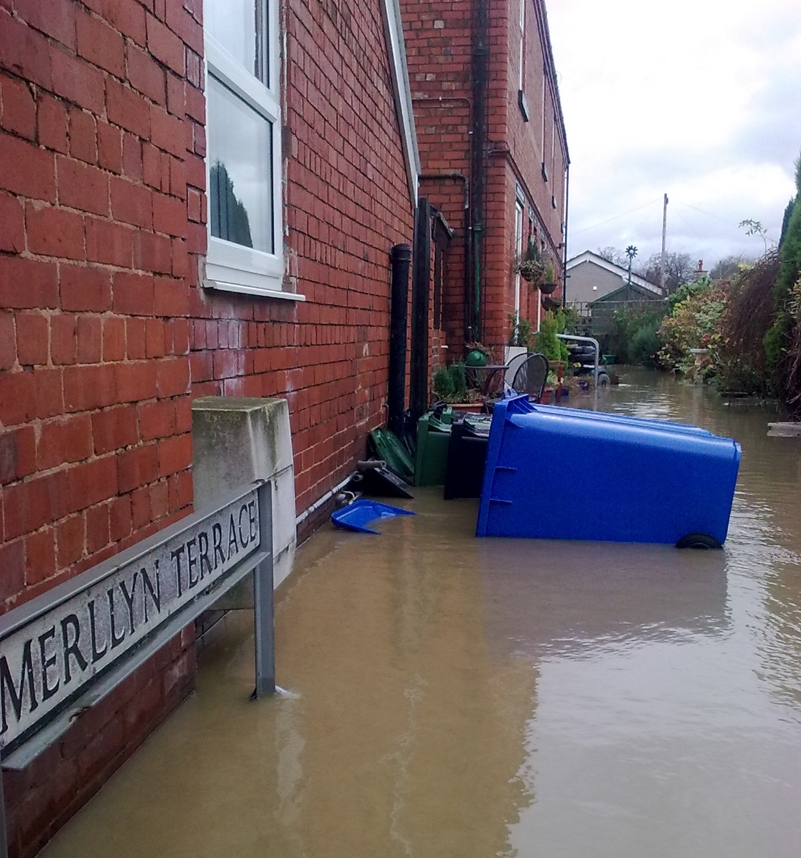
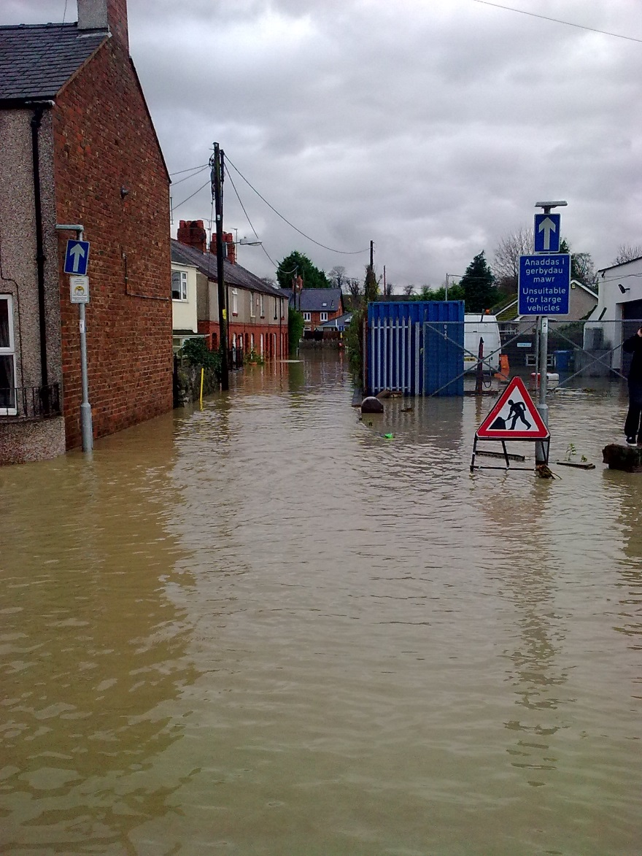
Flood Damage

Slide 14
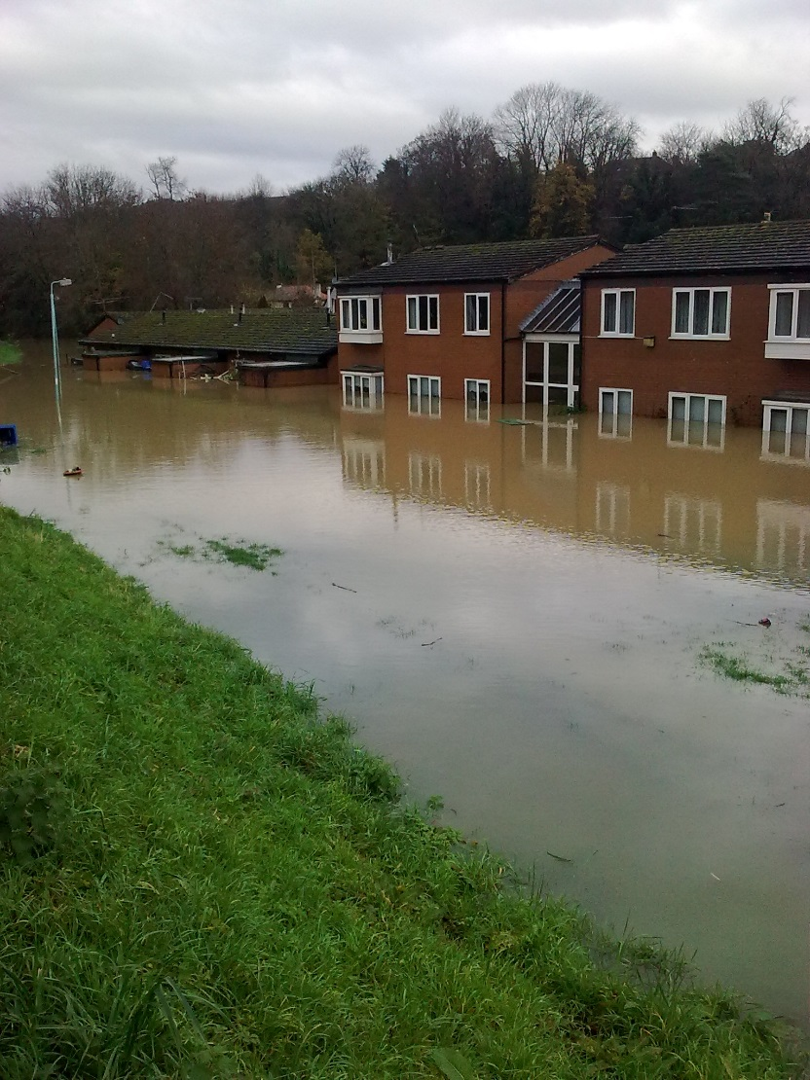
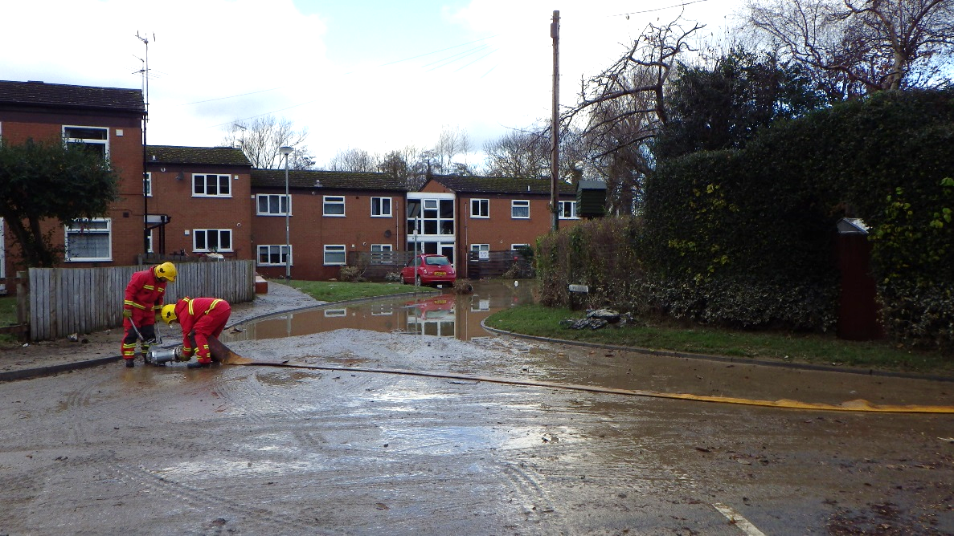
Flood damage
Llys y Felin Sheltered Housing, St. Asaph

Slide 15
Preparing for a flood and dealing with the aftermath
https://www.youtube.com/watch?v=KXbpVPyH52E
Joanne from St Asaph talks about her experience of flooding in her home and shares her practical tips on what to do if you face flooding.
5.29 minutes

Slide 16
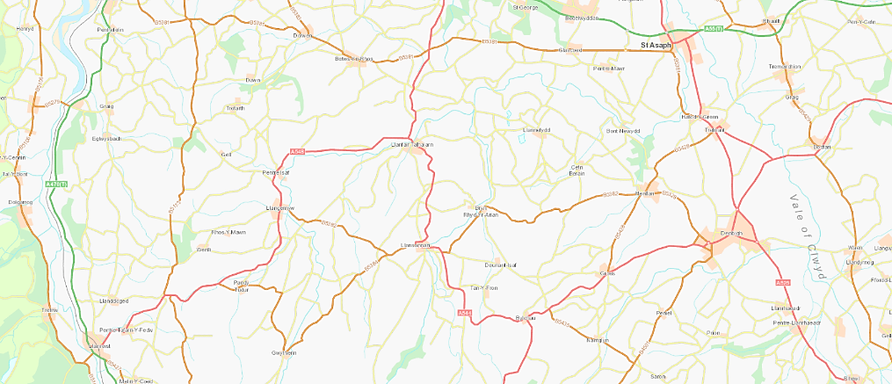
Rainfall during the 2012 St. Asaph floods
26.11.12: 71 mm of rain recorded at Pont y Gwyddel rain gauge
25.8 mm of rain recorded at St. Asaph rain gauge
Notes:
For further info see St Asaph Data Resources KS2/3 or KS4/5.

Slide 17
River Elwy flows during the 2012 St. Asaph floods
Data gathered from the Pont y Gwyddel gauging station November 2012
1 cumec = 1 cubic metre passing a given point per second.
A cumec is a unit used to measure the rate of flow of water.
Date | Mean daily m³/s or cumecs
24/11/2012 | 14.2
25/11/2012 | 23.7
26/11/2012 | 94.4
27/11/2012 | 62.3
28/11/2012 | 19.6
29/11/2012 | 12.8
Notes:
A cumec is a unit used to measure the rate of flow of water at that moment in time.
Different flow rates can be used for the same point in a river to produce option models for flood alleviation schemes.

Slide 18
Graph demonstrating the recorded flow at Pont y Gwyddel

Slide 19
St. Asaph Flood Risk Management Scheme
Standard of Protection - A flood defence standard of protection calculates an estimated level of risk to a specific area from flooding from the sea or a river.
Standard of Protection (SoP) | % Likelihood of flooding happening
1 in 1,000 annual event probability | 0.1% chance of flooding in any given year, very low probability
1 in 200 annual event probability | 0.5% chance of flooding in any given year, low probability
1 in 100 annual event probability | 1% chance of flooding in any given year, medium probability
1 in 50 annual event probability | 2% chance of flooding in any given year, medium probability
1 in 20 annual event probability | 5% chance of flooding in any given year, high probability
The November 2012 flood was estimated to have been between a 1 in 100 (1%) and 1 in 200 (0.5%) annual probability event.

Slide 20
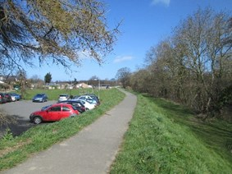
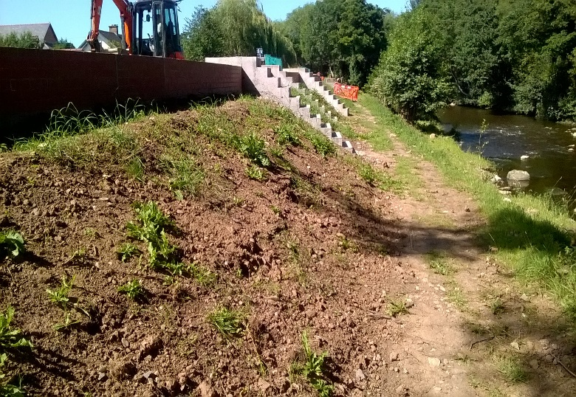
St. Asaph Flood Risk Management Scheme
Recreation Ground: Raising and widening the embankment along the existing line of defence
Notes:
Following a detailed investigation after the flooding in 2012, NRW identified a long list of options to help improve flood protection for the city.
The options included:
Measures to store rainwater upstream and reduce flows down through the city
Natural flood defence methods, such as using trees and vegetation to slow down river flows
Replacing the Spring Gardens bridge to a higher height so as to not restrict flows during heavy rainfall
Further raising of the existing flood defences along the River Elwy
These were initially reduced to a short list. - reviewed against cost, technical feasibility, environmental factors and ability to adapt against future climate change - before the preferred solution was selected:
Replacing the Spring Gardens bridge to a higher height so as to not restrict flows during heavy rainfall and the further raising of the existing flood defences along the River Elwy

Slide 21
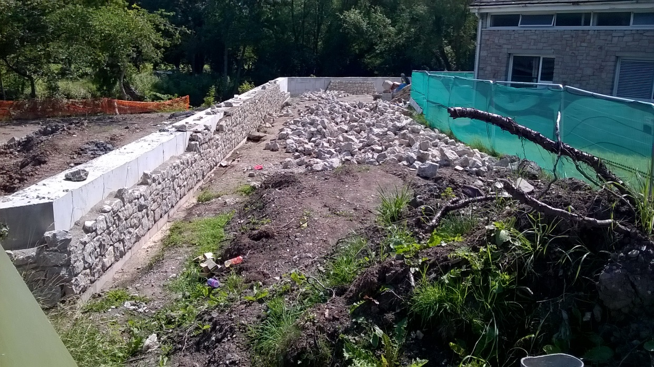
St. Asaph Flood Risk Management Scheme
Notes:
The new Flood Risk Management Scheme will give St. Asaph a 1 in 200 (0.5%) annual event probability standard of protection against flooding.

Slide 22
Video of St. Asaph Flood Risk Management Scheme works
https://www.youtube.com/watch?list=UUPLAYER_NatResWales&v=WmUwKKMATsY
2.34 minutes

Slide 23
St. Asaph Flood Risk Management Scheme – Scheme Benefits
Good for the environment
An interpretation board for St. Asaph Old Bridge Scheduled Ancient Monument
Bird, bat boxes and otter holts installed to increase the biodiversity
Landscaping of embankments and sowing of wild flowers seed mix within the recreation ground
Access to the river encouraged by reducing embankment slope gradient.
Waste and litter bins were installed to help reduce the amount of litter along the riverbank.
Tree and hedgerow planting undertaken

Slide 24
St. Asaph Flood Risk Management Scheme – Scheme Benefits
Good for people
Existing foot and cycle paths that linked to the existing flood defences were widened,
resurfaced and new lengths of footpath installed.
Contribution made towards the installation of sculptures along the river embankments to add to the appeal of the riverside walks.

Slide 25
Any questions?

