Slide 1
Landscape Architects Delivering Green Infrastructure Solutions
How Landscape Architects uniquely support the Welsh Government's legislative ambitions through place-based Green Infrastructure solutions
Andrew Osborne
Notes:
Over the last five years the Welsh Government has attempted to put Wales on course for a more sustainable future, using a raft of new legislation.
This requires identifying innovative ways of delivering services to tackle societal challenges like climate change, poverty, biodiversity loss, sustainable economic development to name just a few.
This presentation is designed to illustrate the key role that Landscape Architects can play in providing real-world solutions on our collective journey.
A journey which must fully embrace the latest design solutions that are being developed both in Wales and around the world.
Solutions that will fundamentally change how we conceive of, and use, the spaces around us.
How we manage existing and create new places will present social, cultural, environmental and economic solutions to our nation’s needs.
Green Infrastructure can meet many of the challenges set by the new legislation.

Slide 2
Place-Based Solutions
Landscape Institute commissioned a report to identify the spatial dimensions of new Welsh legislation that can be delivered by the wider adoption of Green Infrastructure solutions.
The report analysed five Acts and identified 15 key legislative ambitions where Green Infrastructure solutions have a unique ability to deliver.
The Vision –
Wales has a well-connected multifunctional green infrastructure network of high quality green spaces which offer benefits for people and wildlife. The network’s integrity and connectivity is maintained, protected and enhanced in a planned and managed way, which recognises the interdependency and multi-functionality of landscape, heritage and biodiversity.
Notes:
Earlier this year the LI launched an initiative designed to “offer solutions to the Welsh Government and key partners to help them deliver the spatial aspects of the new Welsh legislation via the Green Infrastructure approach”.
To do this we commissioned a report which: 1. built on the vision explored by the Wildlife Trust and: 2. assessed five key Acts of the last Assembly.
The Well-being of Future Generations Act
The Planning Act
The Environment Act
The Active Travel Act
The Historic Environment Act
The report identifies solutions by focusing on policy connections, how GI connects people, contributes to a prosperous Wales, a resilient environment, creates a healthier and more equal Wales, is good for the community, Welsh language and culture, and helps tackle climate change.
Green infrastructure provides an opportunity to support all these strands, through Landscape architecture; the profession best able to provide a holistic approach to creating places where people live and work - both now and in the future.
Of course GI needs to encompass semi-natural habitats including forests, moors, downs, wetlands and coastlines, as much as urban areas. GI connects people within urban areas and to places for active recreation, including more remote places.

Slide 3
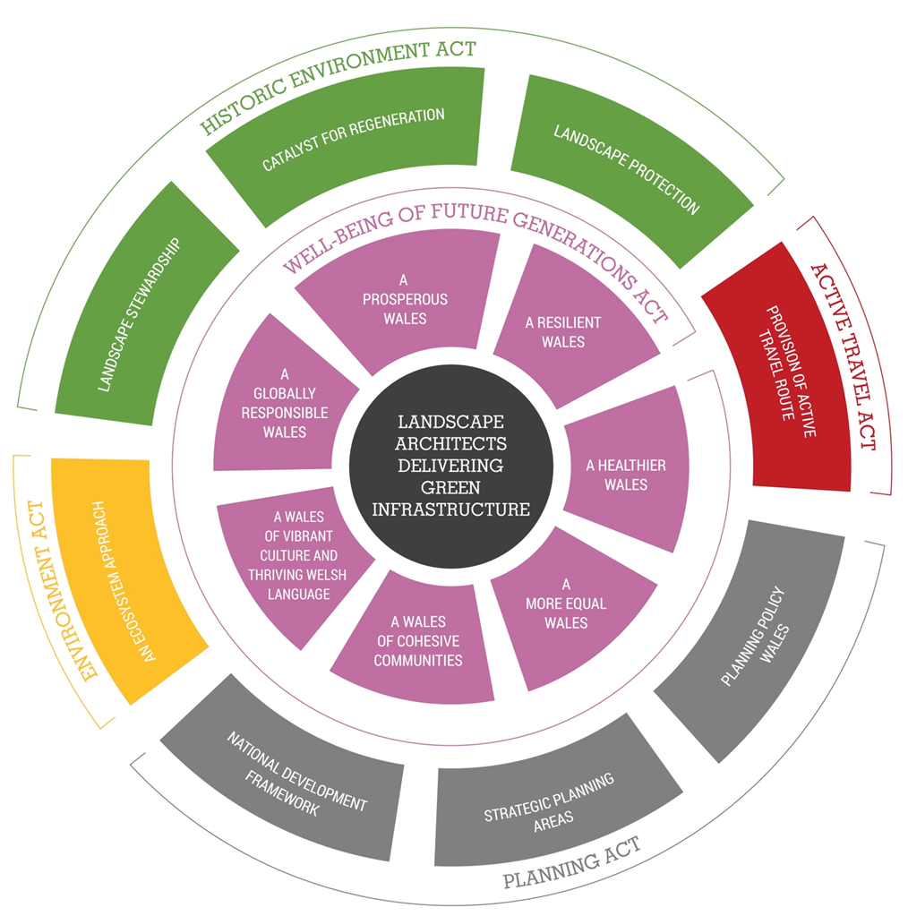
Notes:
Reviewing the five Acts, this infographic highlights 15 core principles which we picked out. I’ll explain it first before we examine 5 real world examples of GI and look at the different ways in which they support these principles.
First on the inner ring we have the seven goals of the Well-being of Future generations Act - designed to underpin all the Government’s operations and how it and the wider public sector deliver services across Wales.
Next we have what I’ll term the framework and delivery Acts.
First in Green we have the Historic Environment Act. At its heart this Act can be understood as a mechanism to deliver the three principles of Landscape Stewardship, providing a Catalyst for Regeneration and of course Landscape Protection.
Then we have the bespoke Active Travel Act in Red. The Act really has one principle - simply to provide for active travel routes across Wales. In terms of connected routes the Act has the real potential to provide a step change in our thinking and reduce the fragmentation in sustainable transport links so often experienced. On top of this there is of course the contribution these networks make to encouraging a more healthy population.
Next we have the Planning Act which creates a framework for the preparation of a National Development Framework; Strategic Planning Areas; and an updated Planning Policy Wales. Although we are awaiting more detailed guidance, now that all of the legislation is in force, we know they must be consistent with the seven WFG goals.
Finally in yellow we have the Environment Act, providing a framework which positions Wales as a low carbon, green economy, ready to adapt to the impacts of climate change. Part 1 focuses on the Sustainable management of natural resources – which enables Wales’ resources to be managed in a more proactive, sustainable and joined-up way using what Government traditionally terms the ‘Ecosystem Approach’
As we look through 5 examples of GI solutions in place, both in Wales and across the wider globe, our case studies highlight which of these 15 legislative principles are being met by existing projects, and also how other projects have the potential to meet them in different ways.
To give a visual explanation of this we’ve pulled out these principles on each of the slides – a methodology I would suggest could be used or adapted for use in developing projects in Wales.
However just before that, I feel I must mention something about one of the 7 goals, a Healthier Wales.

Slide 4
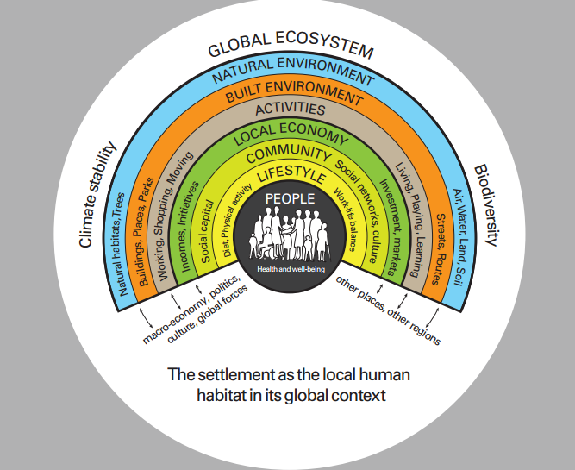
Notes:
Given recent health statistics, particularly relating to Type II Diabetes, a preventable illness, there has never before been a greater need to highlight the health and wellbeing benefits of GI. Mention the £10 Billion obesity bill – 10% of the health budget.
The Landscape Institute recognises that improving health and wellbeing through greater consideration of the role of landscape is a two-way street. To this end, we need promote awareness and knowledge of public health and well being, so that our members are well-equipped to integrate positive health outcomes into their work.
The following 10 recommendations are a starting point for embedding the role of GI in delivering wellbeing benefits at all levels of government and at all spatial scales.
1 - A bigger role for wellbeing in place making. The public health sector needs to be more closely involved in guiding the planning, design and management of new and existing settlements to help ensure healthy, sustainable places everywhere.
2 - Resource commitment. Public health should be granted the same long-term budgetary commitment that primary care, transport and other public services receive. There is already a great deal of policy support for improving public health outcomes across the UK. What we need now is more resources and longer-term funding for programmes that deliver health and wellbeing benefits through landscape.
3 - Local planning policy needs to adopt the requirements that have been set out in national planning policy. To include the promotion of public health and wellbeing as an essential part of creating sustainable communities.
4 - Recognise landscape as an asset. The role of landscape in promoting public health and wellbeing should be a central consideration in the preparation of Joint Strategic Needs Assessments and Joint Health and Wellbeing Strategies.
5 - Use landscape in performance indicators for wellbeing. Greater consideration should be given to ways in which better planned, designed and managed landscapes can contribute to achieving targets set out within performance management frameworks
6 - Collaboration is key. Professionals responsible for public health, landscape and planning should work together on the creation and assessment of schemes in both the public and private sector.
7 - Recognise the multifunctional benefits that landscape offers. Public health and planning professionals should recognise the multifunctional nature of landscape and its potential to offer positive public wellbeing outcomes.
8 - Use Health Impact Assessments. Landscape professionals should make use of tools such as Health Impact Assessments to assess the ways in which their projects can contribute towards positive health outcomes.
9 - Ensure community buy-in. Landscape professionals should use an inclusive, participatory design process, to ensure greatest possible buy-in from key stakeholders.
10 - More evidence. Further funded research is needed to fill key evidence gaps, such as post-occupancy evaluations.

Slide 5
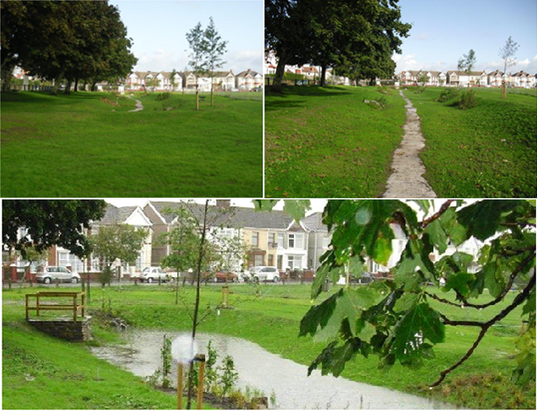
Water Management : Llanelli Rainscape
Llanelli - risk from surface water flooding due to its combined surface & waste water sewers.
In response Dwr Cymru – Welsh Water designed a £15m programme to better manage rainwater.
The plan delivered a range of green infrastructure projects to “catch, redirect and slow down the speed at which rainwater enters the local sewer network. At the same time, it [helped] create a greener, cleaner place to live.”
Basins and Planters
Swales and Grass Channels
Porous Paving
Below Ground Storage
An Ecosystem Approach
An Ecosystem Approach
A Prosperous Wales
A Prosperous Wales
Provision of Active Travel Route
Provision of Active Travel Route
A Resilient Wales
A Resilient Wales
A Healthier Wales
A Healthier Wales
A More Equal Wales
A More Equal Wales
A Wales Of Cohesive Communities
A Wales Of Cohesive Communities
A Wales Of Vibrant Culture And Thriving Welsh Language
A Wales Of Vibrant Culture And Thriving Welsh Language
A Globally Responsible Wales
A Globally Responsible Wales
Landscape Stewardship
Landscape Stewardship
Catalyst for Regeneration
Catalyst for Regeneration
Landscape Protection
Landscape Protection
National Development Framework
National Development Framework
Strategic Planning Areas
Strategic Planning Areas
Planning Policy Wales
Planning Policy Wales
Notes:
Llanelli provides a good place to start because the scheme is so well known, providing a great GI solution to water management issues.
Make reference to the box – 15 core principles.
Welsh Water delivered a £15m scheme which altered the semi-urban landscape in a way which provides a solution to local needs.
Yet the scheme was able to do far more than simply catch, redirect and slow down the speed at which rainwater enters the local sewer network.
The scheme brought new:
Basins and Planters
This is the instillation of shallow landscaped basins which are able to store and treat excess surface runoff. On site filters sift through the water before releasing it into the surrounding soil and sewer network.
Swales and Grass Channels
Long, shallow landscape channels capable of holding significant amounts of rainwater. These enable the water to then gradually enter the surrounding soil and sewer network.
Paving & Storage
Rainwater is able to penetrate pavement surfaces and kerbs rather than immediately entering the existing sewer network. The water is then slowly released from storage tanks into the network.
Yet looking in a wider sense this case study also shows GI meeting other legislative principle. For example it also provided new community spaces to build local cohesion. It gave the area new routes for active travel in the form or cycle and foot paths. And by increasing the capacity in the water network it also worked to enable relegation to become a real possibility.

Slide 6
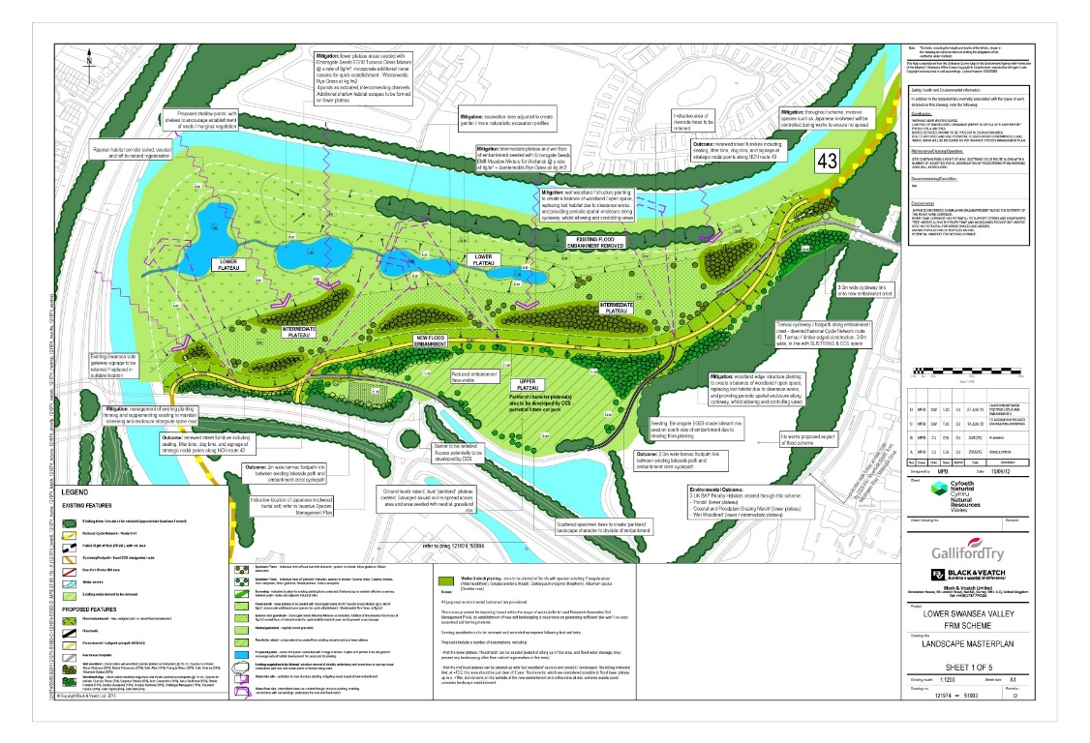
Flood Risk: Lower Swansea Valley FRMS
A densely wooded river corridor flanked with public footpaths / cycleways and linear green spaces, connecting a series of enterprise parks, industrial estates, residential areas & economic development sites.
A key landscape design priority was to minimise the landscape and visual effects of the new engineered structures. It worked well because the programme allowed overlap between design development and the Landscape and Visual Impact Assessment processes, and because the landscape team was well integrated.
An Ecosystem Approach
An Ecosystem Approach
A Prosperous Wales
A Prosperous Wales
Provision of Active Travel Route
Provision of Active Travel Route
A Resilient Wales
A Resilient Wales
A Healthier Wales
A Healthier Wales
A More Equal Wales
A More Equal Wales
A Wales Of Cohesive Communities
A Wales Of Cohesive Communities
A Wales Of Vibrant Culture And Thriving Welsh Language
A Wales Of Vibrant Culture And Thriving Welsh Language
A Globally Responsible Wales
A Globally Responsible Wales
Landscape Stewardship
Landscape Stewardship
Catalyst for Regeneration
Catalyst for Regeneration
Landscape Protection
Landscape Protection
National Development Framework
National Development Framework
Strategic Planning Areas
Strategic Planning Areas
Planning Policy Wales
Planning Policy Wales
Notes:
The Swansea project is on a different scale.
The project is located along a 4km stretch of the River Tawe, two miles north of Swansea City Centre.
Make reference to the box – 15 core principles.
Key Objectives - to deliver improved flood protection for over 300 businesses and homes through a range of measures including increasing capacity by:
setting back existing defences,
constructing improved raised flood embankments and walls,
removing three redundant bridges and providing one new pedestrian bridge.
The project is predicted to generate £28 million of benefits to the wider economy as a result of the reduced flood risk, and was successfully tested when the Tawe burst its banks during a flood event in October 2013, while construction was still underway.
A key landscape design concept developed was to visually re-connect the very densely vegetated green corridor with the river. It included habitat creation targets, including new areas of wet grassland, wildflower meadow and wet woodland.
The planting design concepts included the need to retain the character and ecological value derived from the continuity of tree cover along the river corridor, to use large scale planting to integrate new flood defence structures into the landscape and control and direct views, but also to allow for improved visual connectivity with the river.

Slide 7
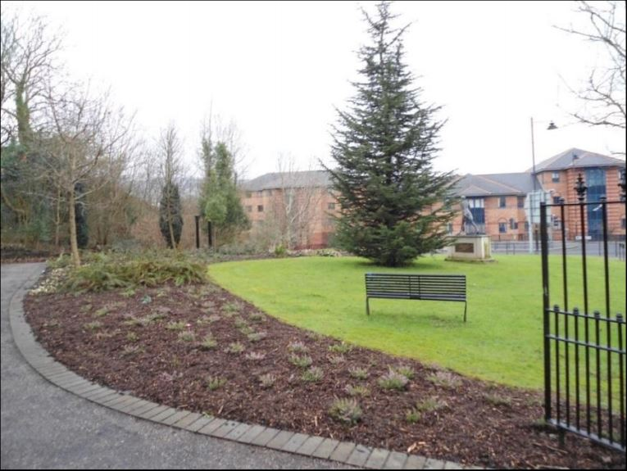
Promote Open Spaces: Merthyr’s Strategy
Identifies types of locally important open space, setting out locally derived quantity, quality and access standards.
Recommends improvements in the quantity, quality and accessibility of open spaces through associated Action Plans based on the key themes and aims of the Strategy:
To inform and help interpret the Council’s local development plan (LDP) policies relating to the provision of open space in new developments and the protection of existing open space.
To inform the site-management of open spaces
As a mechanism for directing funding to appropriate sites where improvements to the quantity, quality and accessibility of open spaces can be made.
An Ecosystem Approach
An Ecosystem Approach
A Prosperous Wales
A Prosperous Wales
Provision of Active Travel Route
Provision of Active Travel Route
A Resilient Wales
A Resilient Wales
A Healthier Wales
A Healthier Wales
A More Equal Wales
A More Equal Wales
A Wales Of Cohesive Communities
A Wales Of Cohesive Communities
A Wales Of Vibrant Culture And Thriving Welsh Language
A Wales Of Vibrant Culture And Thriving Welsh Language
A Globally Responsible Wales
A Globally Responsible Wales
Landscape Stewardship
Landscape Stewardship
Catalyst for Regeneration
Catalyst for Regeneration
Landscape Protection
Landscape Protection
National Development Framework
National Development Framework
Strategic Planning Areas
Strategic Planning Areas
Planning Policy Wales
Planning Policy Wales
Notes:
On a larger scale Merthyr Council’s Open Spaces strategy covers areas which are well-designed and maintained making a significant contribution to quality of life. It provides a long term framework to protect and develop a network of high-quality open spaces that deliver a range of social, economic and environmental benefits – all of which are clearly inline with what the Welsh Government are seeking.
Make reference to the box – 15 core principles.
Open spaces come in a range of forms, but for the purpose of the Strategy, eight types of locally important open spaces were determined. These were:
allotments and community growing space,
amenity greenspace, children and young people’s space,
civic space,
green leisure corridors,
multifunctional green space,
natural/semi natural greenspace,
outdoor sports areas and pitches and
Public parks and gardens.
The Strategy identifies the different types of open space which are locally important and sets out locally derived quantity, quality and access standards, with associated Action Plans for each ward. These recommendations are based on the key themes and aims of the Strategy.
I think what is key with this is that it again brings us away from fragmented thinking and starts to think about connected larger GI networks.

Slide 8
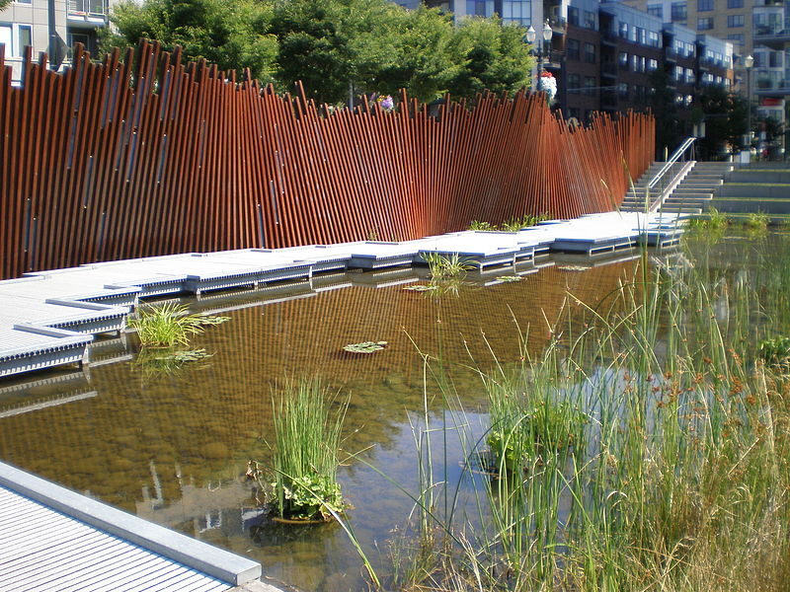
Industrial Heritage: Tanner Springs Park
Tanner Springs Park in Portland, Oregon was constructed on a disused and contaminated industrial site that was a wetland before human settlement.
The project grew from a local desire to reconnect Portland with both its ecological and industrial history.
It recreates industrial landscapes through the use of materials such as rail tracks and basalt blocks combining them with a closed-loop rainwater system which stores excess water.
An Ecosystem Approach
An Ecosystem Approach
A Prosperous Wales
A Prosperous Wales
Provision of Active Travel Route
Provision of Active Travel Route
A Resilient Wales
A Resilient Wales
A Healthier Wales
A Healthier Wales
A More Equal Wales
A More Equal Wales
A Wales Of Cohesive Communities
A Wales Of Cohesive Communities
A Wales Of Vibrant Culture And Thriving Welsh Language
A Wales Of Vibrant Culture And Thriving Welsh Language
A Globally Responsible Wales
A Globally Responsible Wales
Landscape Stewardship
Landscape Stewardship
Catalyst for Regeneration
Catalyst for Regeneration
Landscape Protection
Landscape Protection
National Development Framework
National Development Framework
Strategic Planning Areas
Strategic Planning Areas
Planning Policy Wales
Planning Policy Wales
Notes:
Wales’ industrial legacy and living languages are something to be celebrated. But that legacy has left us with a number of disused and polluted areas which GI enables us to bring back into use while also offering us an opportunity to promote our languages in an inclusive way.
Make reference to the box – 15 core principles.
Tanner Springs Park in Portland, Oregon is an exciting example of the kind of GI solution which Wales could easily embrace. Its designers describe the area as:
Formerly a wetland, the Pearl District was bisected by Tanner Creek and sided by the broad Willamette River. Rail yards and industry first claimed and drained the land. Over the past 30 years, a new neighbourhood has progressively established itself – young, mixed, urban and dynamic, today the Pearl District is home to families and businesses within a new city park.
Stormwater runoff from the park block is fed into a natural water feature with a spring and natural cleansing system. An `Art Wall´ recycles historic rail tracks, oscillating in and out and inlaid with fused glass pieces hand-painted with nature images. Ospreys dive into the water, art performances unfold on the floating deck, children splash and explore, and others take quiet contemplation in this natural refuge in the heart of the city. An intense community participation and a stakeholder steering group means that this park is the realisation of the dreams and hopes of local people.
Such schemes have a real potential to make a difference in Wales and unable to us to celebrate our heritage, address issues such as legacy contamination and to do so in a way which creates new bilingual spaces.

Slide 9
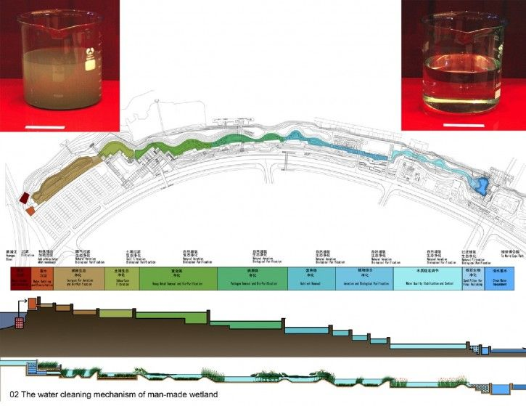
Biodiversity: Shanghai Houtan Park
Cleans up to 634,000 gallons of polluted river water daily, improving the water’s quality from Grade V (unsuitable for human contact) to Grade II (suitable for landscape irrigation) using only biological processes.
Increased the biodiversity of the site dramatically, with 93 species of plants and over 200 species of animals observed.
Saves $116,800/year in water treatment costs at the adjacent Expo Park where 264,000 gallons of water is treated by Houtan Park’s wetland purification system for use in the water features.﻿﻿
Reduced waste and saved an estimated $17,300 by reusing 37 tons of steel and roughly 34,000 post-industrial bricks found on the site
An Ecosystem Approach
An Ecosystem Approach
A Prosperous Wales
A Prosperous Wales
Provision of Active Travel Route
Provision of Active Travel Route
A Resilient Wales
A Resilient Wales
A Healthier Wales
A Healthier Wales
A More Equal Wales
A More Equal Wales
A Wales Of Cohesive Communities
A Wales Of Cohesive Communities
A Wales Of Vibrant Culture And Thriving Welsh Language
A Wales Of Vibrant Culture And Thriving Welsh Language
A Globally Responsible Wales
A Globally Responsible Wales
Landscape Stewardship
Landscape Stewardship
Catalyst for Regeneration
Catalyst for Regeneration
Landscape Protection
Landscape Protection
National Development Framework
National Development Framework
Strategic Planning Areas
Strategic Planning Areas
Planning Policy Wales
Planning Policy Wales
Notes:
Our final case study is perhaps one of worlds most ambitious GI solutions: Shanghai’s Houtan Park.
Make reference to the box – 15 core principles.
This massive project, built for the 2010 Shanghai World Expo, uses GI to provide a solution to a series of environmental issues and shows what is possible when sustainable technologies are applied.
Before work began the area was a brownfield site used as a landfill and storage yard.
The water of the Huangpu River was highly polluted, considered unsafe for swimming and recreation, and devoid of aquatic life.
Another challenge was flood control. The existing 22-ft high concrete floodwall combined with daily tidal fluctuations created an inaccessible, muddy, and littered shoreline, so an alternative flood control design was necessary. A third challenge was the shape of the linear waterfront site. Because it is extremely narrow at many points, creating a complete wetland to foster cleaning of the water would be difficult. The narrow points also made access and pedestrian circulation challenging. The park design would need to accommodate the hundreds of thousands of visitors expected during the 6-month Expo, while creating a pleasant and accessible human-scale public park for the long-term.
The solution to these challenges was to use the design concept of a living organism that has the ability to adapt, change, and protect itself, Houtan Park was built as a regenerative living system with a constructed wetland, cascades, and terraces that oxygenate the river water and remove pollutants, nutrients, and sediment. The wetland also acts as a flood protection buffer.
Houtan Park’s aesthetic qualities and ecological functions ensure its continued success long after the Expo as it retains thousands of visitors a year.
While we are lucky that Wales no longer has water contamination on this scale, this case study enables us to see the value in managing our landscapes by supporting the living things that they are.

Slide 10
Place-Based Solutions
Challenge
Changing the way GI is prioritised alongside other services & how we plan for, design & deliver development – A step change from current practice.
Solution - Use Landscape Architects;
To undertake GI appraisals with local communities; to identify, maintain and integrate GI assets that function well and improve those that are working less well – produce a GI framework plan.
In the development management process at large and small scales.
To produce the detailed designs of SuDS, landscape (buffer) planting, habitat creation etc; contract management, project management & landscape management.
To produce regional green infrastructure strategies and local development frameworks (identifying sustainable development sites); that support legislation and new national policy.
Notes:
Coming back to Wales, the biggest issue is changing the way we prioritise GI, plan for development and how we design & deliver development – A step change from current practice.
Our solution is to:
Use Landscape Architects to undertake GI appraisals with local people; to identify, maintain and integrate GI assets that function well and improve those that are working less well – ie produce a GI framework plan.
Use Landscape Architects in the development management process... at a large and small scale
Use Landscape Architects to produce the detailed designs of SuDS, landscape (buffer) planting, habitat creation etc; contract management, project management & management.
4. Using landscape architects to produce regional green infrastructure strategies and local development frameworks (identifying sustainable development sites); that support legislation and national policy. On a neighbourhood scale it’s all about understanding the site, its context and identifying opportunities to improve GI, and connections to the wider local and regional GI assets.
Building upon what we saw from our case studies, it is important to take a strategic approach to integrated GI because it provides a focus for multiple initiatives operating at various scales. Local or neighbourhood level projects can contribute incrementally to the bigger landscape-scale picture, so that the whole becomes greater than the sum of its parts
We want local authorities to ensure that GI is a core requirement in their policy documents, such as development plans and development briefs. By its nature, GI often crosses administrative and operational boundaries, and we believe that this should be addressed through joint-working between national bodies and local authorities.
We recommend that developers be aware of an area’s strategic GI goals and appreciate how those goals contribute to mitigating the environmental impacts of new development and creating beautiful places.
We urge clients to champion GI as part of a shared vision and that is planned, delivered and managed effectively from the start. And we encourage landowners to think creatively about how to generate capital and revenue to ensure that GI is well funded for ongoing management and maintenance.
The challenges we face today are too often approached as separate issues. There is insufficient consideration given to the complex interactions between, for example, housing, flood management, food growing and biodiversity. This approach prevents us from adopting more dynamic, integrated and forward-thinking solutions. GI offers an alternative to this narrow-minded approach – a way not only of tackling specific challenges head on, but of realising multiple secondary benefits at the same time. It is this integrated approach that will unlock the potential of our landscape.

Slide 11
Six recommendations for how to deliver the next generation of green infrastructure
1. Local authorities - Turn strategic GI thinking into reality
2. Local authorities Health Boards & Business Improvement Districts - Promote collaboration on GI across boundaries
3. Developers - New developments should make a contribution to GI
4. Clients - Champion GI that is planned, designed and managed effectively
5. Landowners - Ensure GI is well-funded for ongoing management and maintenance
6. Landscape professionals - Raise awareness of how GI can deliver multiple benefits
Notes:
To conclude I want to make 6 recommendations which serve as a call to action for different groups across Wales.
Local authorities
Turn strategic GI thinking into reality
Ensure that GI is a core requirement in local authority documents, such as Corporate Plans, Local Plans, Infrastructure Development Plans and development briefs. Proper consideration should also be given to the potential for multifunctional GI to perform some of the roles that ‘grey’ infrastructure is used for, particularly water management and waste. Why? Not only does GI tend to be cheaper, but it also provides infrastructure that is resilient to an increasingly unpredictable climate.
Local authorities, Health Boards and Business Improvement Districts
Promote collaboration on GI across boundaries
By its nature, GI often crosses administrative and operational boundaries, so it should be addressed through the Duty to cooperate between local authorities. It should also be part of the remit of business improvement districts, Local Enterprise Partnerships and importantly, if we are to make any progress tackling our ever increasing health budgets, Health Boards.
Developers
New developments should make a contribution to GI
Developers should be aware of an area’s strategic GI goals and appreciate their role both in mitigating the environmental impacts of new development and in creating beautiful places. Even small interventions contribute to the overall success of GI, so developers should engage with local communities.
Clients
Champion GI that is planned, designed and managed effectively
Successful GI is part of a shared vision – one that appreciates landscape character, sense of place and functionality. Make sure that strategies clearly articulate the vision, priorities, responsibilities and actions needed to plan, deliver and manage GI projects, from the start. Public and private sector landowners and managers should be involved in the planning and design of GI, as their buy-in and expertise is vital to its long-term success.
Landowners
Ensure GI is well-funded for ongoing management and maintenance
Management and maintenance are critical if GI is to continue to deliver long-term benefits. By thinking creatively about how to generate capital and revenue, multifunctional land can be funded from several sources. These could include direct income from renewable energy, food production or events, or indirect savings by reducing flood risk and cutting the cost of cooling in urban areas during hot weather.
Landscape professionals
Raise awareness of how GI can deliver multiple benefits
Landscape professionals need to appreciate what drives their clients. They advise clients, colleagues and decision-makers about the value of GI, from country parks and community woodlands, to development specific interventions such as green roofs and sustainable drainage systems. The range of benefits that GI can deliver needs to be communicated to them in a way that resonates with their own objectives.

